Slide 1
ATLAS small wheels and muon trigger upgrade
Osamu Sasaki
High Energy Accelerator Research Organization (KEK)
INPUTS from
RPC : S.Veneziano
sTGC : N.Lupu and G.Mikenberg
mMegas : V.Polychronakos
MDT : R.Richter and O.Sasaki

Slide 2
Present system and improvement scenario

Slide 3
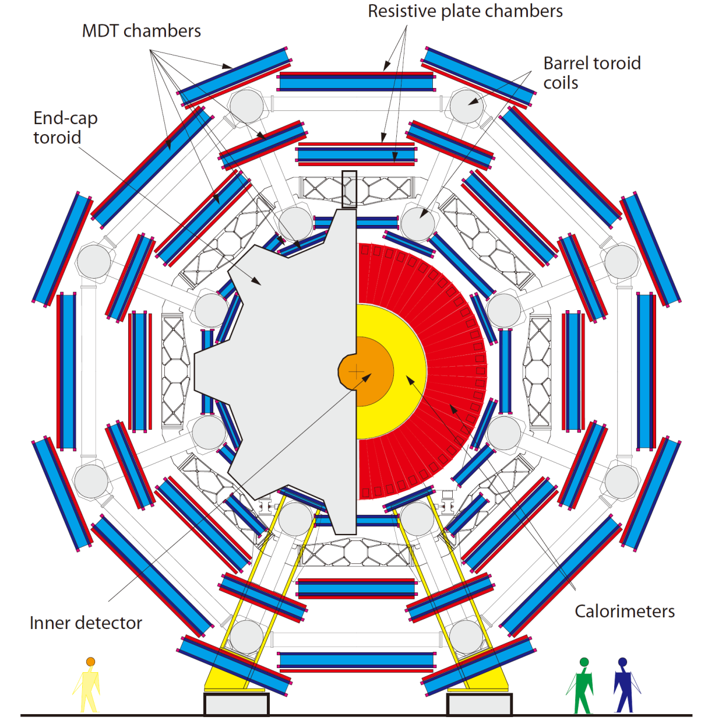
RPC Barrel Upgrade in the Feet Region
LVL1 muon trigger efficiency in the feet sectors is about 50% lower than the one for standard sectors.
In order to recover the efficiency loss, a fourth layer of the RPC (RPC4) has been installed, wherever possible.
Improved to be 80% (pT = 20GeV).
RPC4

Slide 4
Upgraded RPC system
RPC1
Low-pT Pad
RPC2
η : 3/4 coin.
φ : 3/4 coin.
High-pT Pad
Sector Logic
Low pT & 1/2 coin.
η & φ coin.
pT calculation
μ
RPC3
New Low-pT Pad
η : 3/4 coin.
φ : 3/4 coin.
η & φ coin.
MUCTPI
RPC4
40 new Low-pT Pad boards with optical link and 56 splitter boards are needed.
It is under study how to handle the new trigger outputs in terms of sector logic and MUCTPI.

Slide 5
Present detectors of SW + TGC of BW’s
Small Wheel
MDT + CSC
Doublet TGC
Triplet TGC
Doublets TGC
μ
1/2 coin.
hit position
(VERY COARSE)
2/3 coin.
hit position
3/4 coin.
track position and deviation
H-pT Board
RoI, dR, dφ
R-φ coin.
track fitting
pT calculation

Slide 6
New detectors of SW + TGC of BW’s
Small Wheel
Triplet TGC
Doublets TGC
μ
Precision Detector
σ < 100μm
Level-1 Trigger angular resolution of incidence angle
< 1 mrad
Level-1 latency
β
2/3 coin.
hit position
3/4 coin.
track position and deviation
H-pT Board
track fitting
track position (R, φ)
dθ : deviation of incidence angle from infinite pT muons
RoI, dR, dφ
R-φ coin.
track fitting
crossing angle : β
pT calculation
hit information (R, φ) , dθ

Slide 7
Detector Candidates for the Small Wheel
aa

Slide 8
TGC for LVL-1 and precision measurement
Each of the so-called TGC packages consists of 4 TGC gaps.
  Each gap contains 3 mm pitch strips (R), pad-wires (f) and pads for local trigger.
  ~400k independent electronics channels.
Time-over-Threshold signals from strips are used for precision measurement.
  The position resolution with better than 100μm has been demonstrated in test beam.
Hardware centroid circuits of the ToT signals are used for LVL-1 trigger.
Layer | σ_{corr}(σ_{nocorr} )+/- ∆σ [μm]
1 new | 66.2 (120.9) +/- 1.2
2 new | 66.7 (79.8) +/-1.1
3 new | 63.55 (75.95) +/-0.96
4 new | 63.8 (116.4) +/-1.0
5 old | 144.6 (264.1) +/-2.5
6 old | 152.3 (182.1) +/-2.6
7 old | 163.6 (195.6) +/-2.6
8 old | 146.4 (267.2) +/-2.2

Slide 9
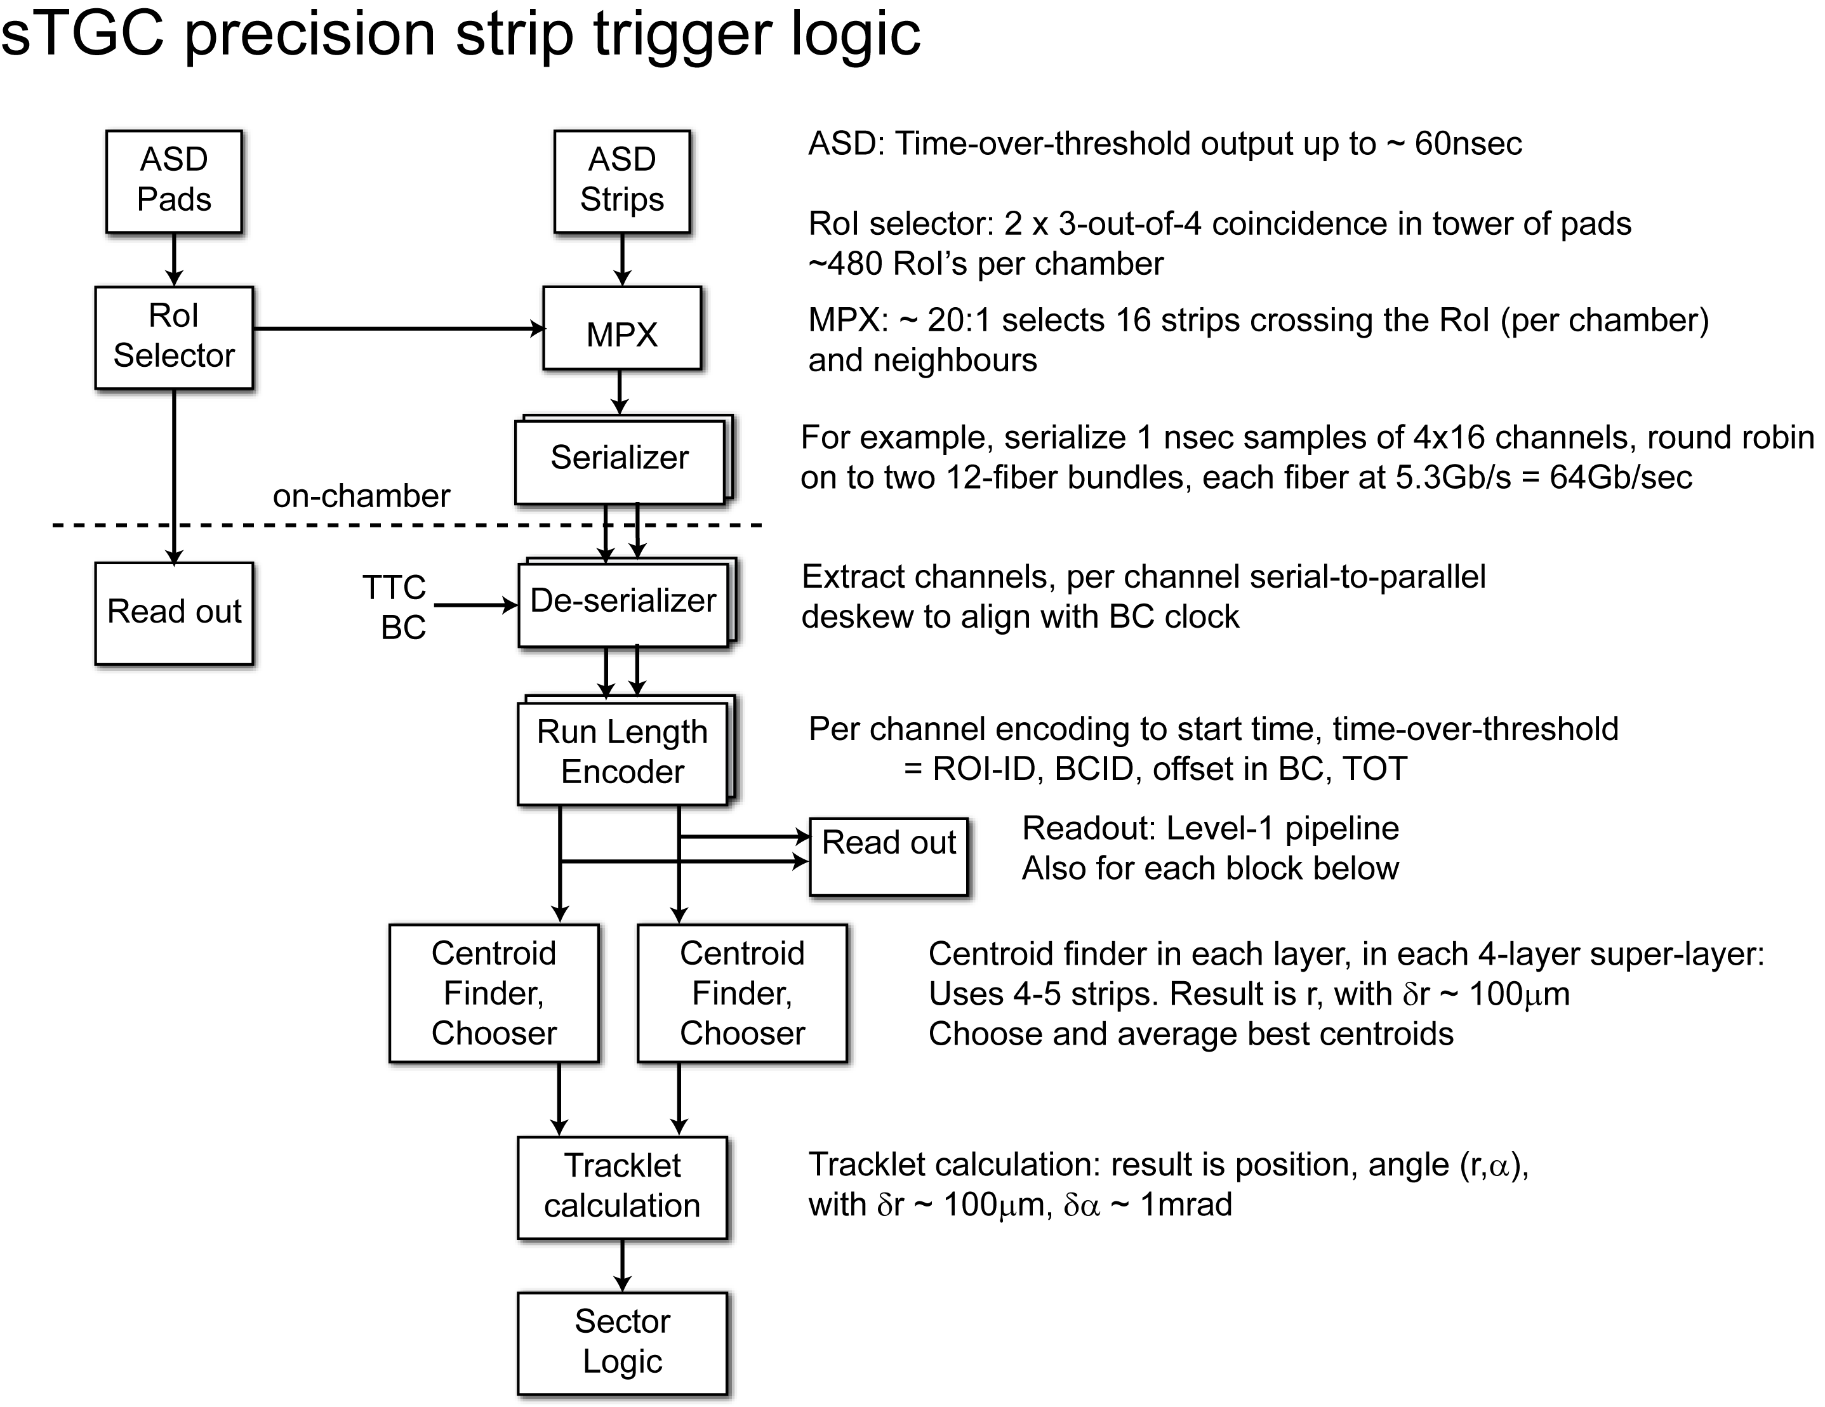

Slide 10
TDC BLOCK DIAGRAM ( CONCEPT WHICH WORKS)
400 MHz 4 PHASES CLK
4 PH.
CLK.
GEN.
0
200 MHz
DIFF. CLK
90
180
270
CLK 0
COUNTER
12 BITS
CLK 90
SUMMING
12 BITS RESULT
of CONVERSION
COUNTER
ToTh
PULSE
CLK 180
COUNTER
CLK 270
COUNTER
THE ToTh INPUT PULSE WIDTH IS FROM
0 TO 255 ns

Slide 11
COMPARATOR & SELECTOR to find the MAXIMUM CHARGE and its INDEX
Q0
8
/
Qmax-1
8
Q1
Compares the 16 Inputs
Finds the Maximum and
its Address.
Outputs the 3 groups of
numbers MAX and the 2
Adjacent groups.
/
ADDmax -1
4
/
Q2
Q max
ADDmax
Q max+1
Q14
ADDmax +1
Q15
Q2

Slide 12
ADDm-1
4
BLOCK DIAGRAM of CENTER of MASS CALCULATION
/
X
Qmax-1
12
/
16
12
/
STRIP PITCH 3500 um
/
ADDm
X
SIGMA
16
X
28
Qmax
/
/
DIVIDEND
ADDm+1
X
Qmax+1
/
CoM
/
28
SIGMA
12
DIVISOR
12
PROG. DELAY
/
/
ADDi Relative address in the 16 strips slice
Qi Charge in units of TDC

Slide 13
Additional latency calculation
The table shows the latency added by the insertion of the sTGC precision strip trigger logic into the existing path from the Inner Layer coincidence logic to the Sector Logic.
We take as a model the Xilinx Virtex6.
All numbers are estimates except that for the centroid finder for which a realistic design has been simulated.
Clock speed = ~400MHz
Yields 2.74/2.80μsec latency
(Existing = 2.55μsec)
 | Min (ns) | Max (ns)
deskew | 25 | 25
ROI selector/ mpx | 10 | 15
serializer | 5 | 10
deserializer | 8 | 16
RLE | 16 | 24
latency for the last sample of the pulse | 64 | 64
find largest signal | 10 | 13
centroid of a layer | 25 | 35
centroid chooser | 10 | 12
centroid average | 5 | 8
tracklet calc (LUT) | 10 | 13
output serializer | 5 | 10
 | 193 | 245

Slide 14
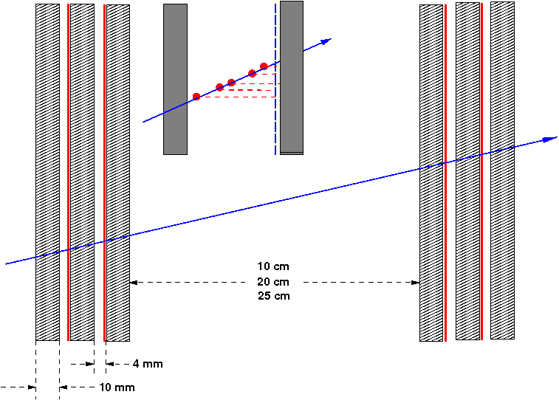
MicroMegas
Mesh
Resistive strips
y strips
2-layer + 2-layer (4 gaps in total) mMegas is foreseen.
  Charge information for precision measurement.
Two-dimensional readout per gap (2D MM)
  2 M channels in total.
Strips with 0.5mm pitch.
  The pitch is fine enough for LVL-1 trigger to reconstruct and find a track with the required resolution using simple discriminator outputs of hit signals. (Information of charge is not necessary.)
PCB
x strips

Slide 15
Some desirable features for mMegas frontend
Real Time Peak Amplitude, Time Detection and on-chip ADC (10-12 bits?)
  Appropriate for a variety of detectors (mMegas, TGC, TPC, GEM, etc) requiring amplitude and time measurement
  on-detector zero suppression, dramatic reduction of data bandwidth
Neighbor channel enabling circuitry (allows relatively high thresholds without losing small amplitudes).
64/128 Channels/chip, simultaneous read/write with Derandomizing Buffers
Able to provide Trigger Primitives for possible on-detector track segment finding logic
  The address of the earliest cluster arrival associated with a given bunch crossing.
  Powerful zero-suppression scheme has to be designed to transmit Trigger Primitives to USA15.
  Address of the strips can be directly used in a Look-up-Table, similar to FTK, in USA15.
Detailed Specifications of back-end to be finalized.

Slide 16
VMM1 IC Block Diagram (not yet finalized)
64 channels/chip, CMOS 130nm, 1.2V, MPW
adj. polarity, adj. gain (0.11 to 2 pC), adj. peaking time (25-200 ns)
derandomizing peak detection (10-bit) and time detection (1.5 ns)
real-time event peak trigger and address
integrated threshold with trimming, sub-threshold neighbor acquisition
integrated pulse generator, calibration circuits, analog monitor, channel mask and temperature sensor
continuous measurement and readout, derandomizing FIFO
few mW per channel, chip-to-chip (neighbor) communication, LVDS interface

Slide 17
Small Tube MDT & TGC of SW + TGC of BW’s
Triplet TGC
Doublets TGC
μ
Thin Tube MDT
& Doublet TGC
β
3/4 coin. Mx
track position (R,φ) deviation (dR,dφ)
2/3 coin.
hit position (R,φ)
3/4 coin. Mx
track position (R,φ) deviation (dR,dφ)
ASD + BCID (40MHz)
coin. Mx
track position (R,φ) deviation (dR,dφ)
hit signal alignment
2 x 3/4 coin.
BCID signal
R-φ coin. Mx
track fitting
crossing angle : β
pT calculation
track position (R)
angle deviation (dθ)

Slide 18
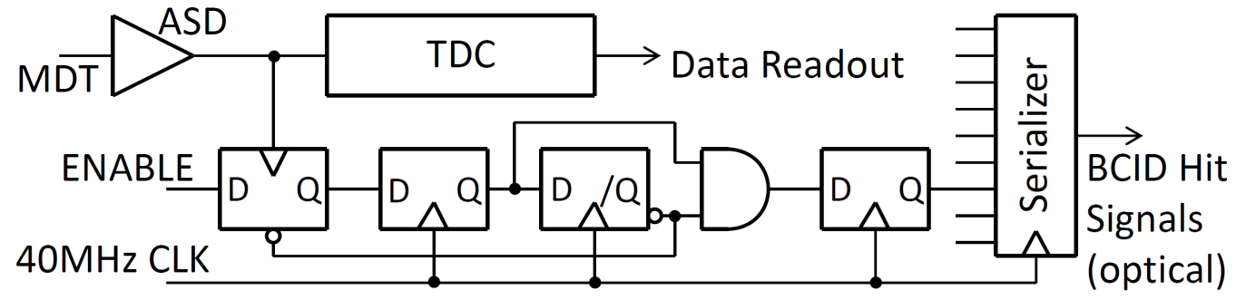
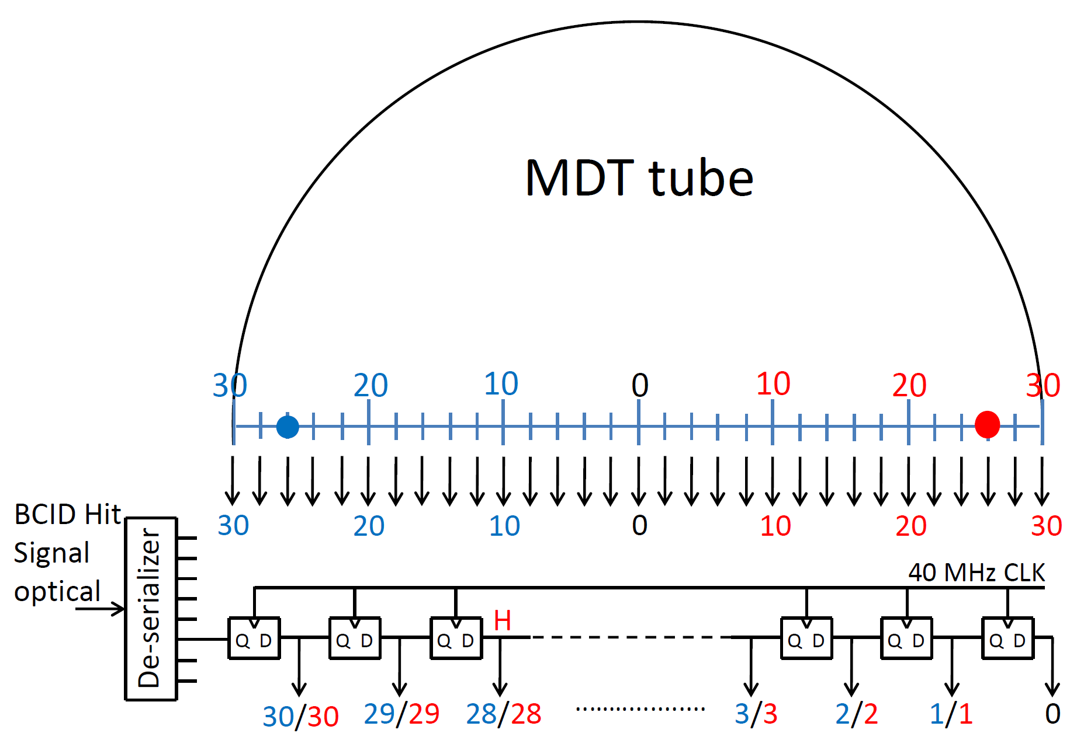
BCID and Decoding circuits

Slide 20
Station (4 x 2 layers) coincidence logic
Aligned hit signals from each layer (1,2,3,4,5,6,7,8 layers) : 0.5mm step
0
1
2
3
4
………….
n
n+1
n+2
n+3
Level-0
Inner layers
The expected track deviations from infinite pT muons is less than ± 1º (pT > 20 GeV), so that one can restrict the track finding window within very narrow area. 3-out-of-4 and 3-out-of-4 coincidences are made for both super-layers individually. Information of position and deviation from both super-layers are combined.
The Level-0 trigger signal from TGC assists the track finding and the BCID.
The tracking efficiency, efficiency holes and the probability of the wrong tacking are to be estimated by the simulation works using real data.
3/4
3/4
Super-layer 2
Super-layer 1
track position/deviation
track position/deviation
track position/deviation

Slide 21
Latency Estimation (<3.2μsec)
Present TGC Level-1 Trigger |  |  |  |  | Thin Tube MDT (SW) + TGC
 | nsec | CLK | Total CLK |  |  | nsec | CLK | Total CLK
TOF from interaction point to TGC | 65 | 2.5 | 2.5 |  | TOF from interaction point to SW (10 m) | 34 | 1.5 | 1.5
Propagation delay on wire/strip | 15 | 1 | 3.5 |  | Propagation delay along wire | 25 | 1 | 2.5
TGC response | 25 | 1 | 4.5 |  | MDT drift time (0 - 200 ns) |  | 8 | 10.5
ASD | 10 | 0.5 | 5 |  | ASD | 10 | 0.5 | 11
Cable to PS-Board (12.5m max.) |  | 2.5 | 7.5 |  | Bunch ID |  | 2 | 13
Variable Delay, Bunch ID, OR and signal routing |  | 2 | 9.5 |  | Serializer (TLK2501 @ 80MHz) + Optical Tx |  | 2 | 15
Variable Delay |  | 1 | 10.5 |  | Optical Fibre Cable (90m) |  | 18 | 33
3/4 Coincidence Matrix or 2/3 Coincidence Logic |  | 2 | 12.5 |  | Optical Rx + De-serializer (TLK2501 @ 80MHz) |  | 3 | 36
LVDS Tx (SN65LV1023) |  | 1 | 13.5 |  | Shift Register (28-steps, 0 - 200 ns) |  | 0 | 36
Cable to H-pT Board (15m max.) |  | 3 | 16.5 |  | coincidence |  | 2 | 38
LVDS Rx (SN65LV1224A) |  | 2 | 18.5 |  | track find |  | 2 | 40
Variable Delay |  | 1 | 19.5 |  | encoding |  | 1 | 41
H-pT Matrix |  | 2 | 21.5 |  | MDT (SW) – TGC(BW) combined HERE |  |  | 44
G-Link Tx (HDMP-1032A) + Optical Transmitter |  | 1.5 | 23 |  | TGC R-φ coin. (LUT) MDT-TGC coin. |  | 3 | 47
Optical Cable to USA15 (90m max.) |  | 18 | 41 |  | crossing angle calculation |  | 3 | 50
Optical Receiver + G-Link Rx (HDMP-1034A) |  | 2.5 | 43.5 |  | pT calculation (LUT) |  | 3 | 53
Sector Logic |  | 7 | 50.5 |  | pT encoding |  | 1 | 54
Cable to MUCTPI (10m) |  | 2 | 52.5 |  | Cable to MUCTPI (10m) |  | 2 | 56
MUCTPI (4 + variable) |  | 11 | 63.5 |  | MUCTPI |  | 11 | 67
Cable to CTP (2.4m) |  | 0.5 | 64 |  | Cable to CTP (2.4m) |  | 0.5 | 67.5
CTP (5 + varable[0-11]) |  | 6 | 70 |  | CTP |  | 6 | 73.5
Cable to LTPi (10m) |  | 2 | 72 |  | Cable to LTPi (10m) |  | 2 | 75.5
LTPi + LTP + TTCvi + TTCex |  | 2 | 74 |  | LTPi + LTP + TTCvi + TTCex |  | 2 | 76.5
Variable Delay |  | 2 | 76 |  | Variable Delay |  | 2 | 78.5
Optical Cable to TGC frontend (110m) |  | 22 | 98 |  | Optical Cable |  | 22 | 100.5
TTCrq + fanout |  | 3 | 101 |  | TTCrq + fanout |  | 3 | 103.5
Cable to PS-Board (5m max.) |  | 1 | 102 |  | Cable to Frontend Electronics |  | 1.5 | 105
 |  |  | 2.55μsec |  |  |  |  | 2.625μsec

Slide 22
Summary

