Slide 1
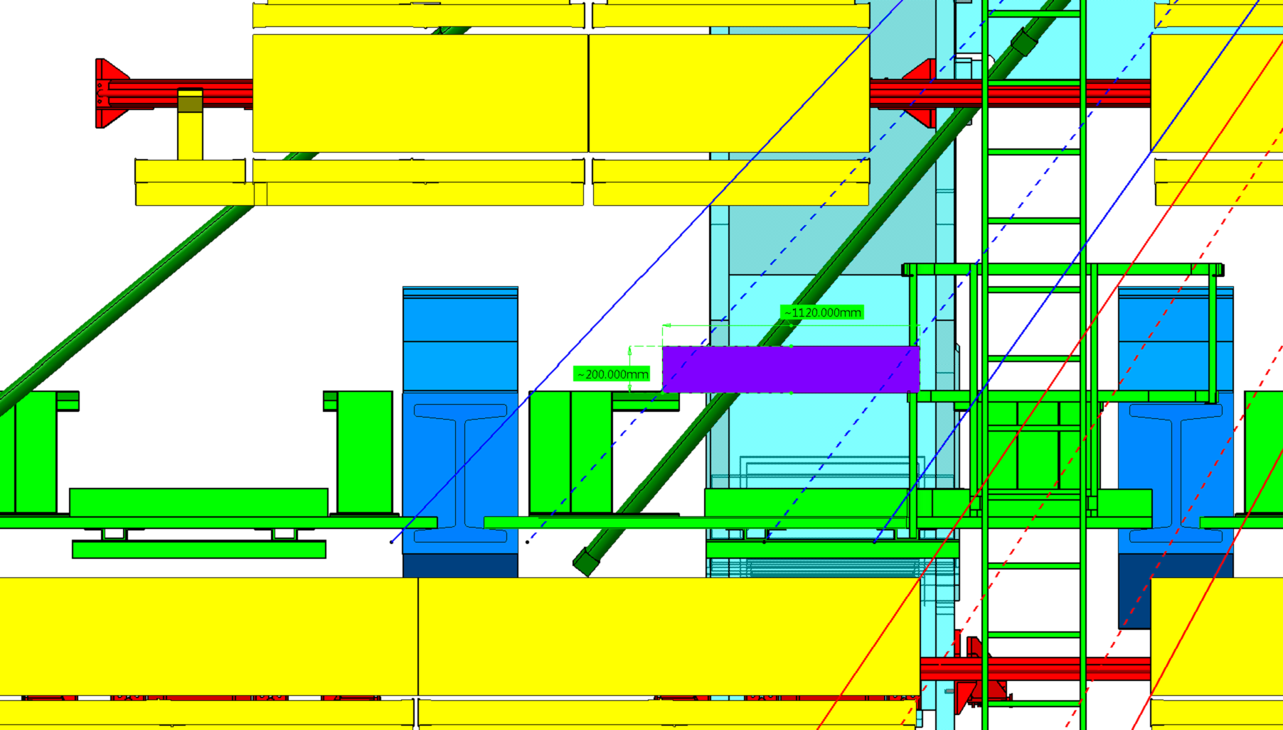
SIDE A,C
In this position chamber can be moved on rails to both sides of elevator
8440 from IP
Z 6250
Another possible chamber position

Slide 2
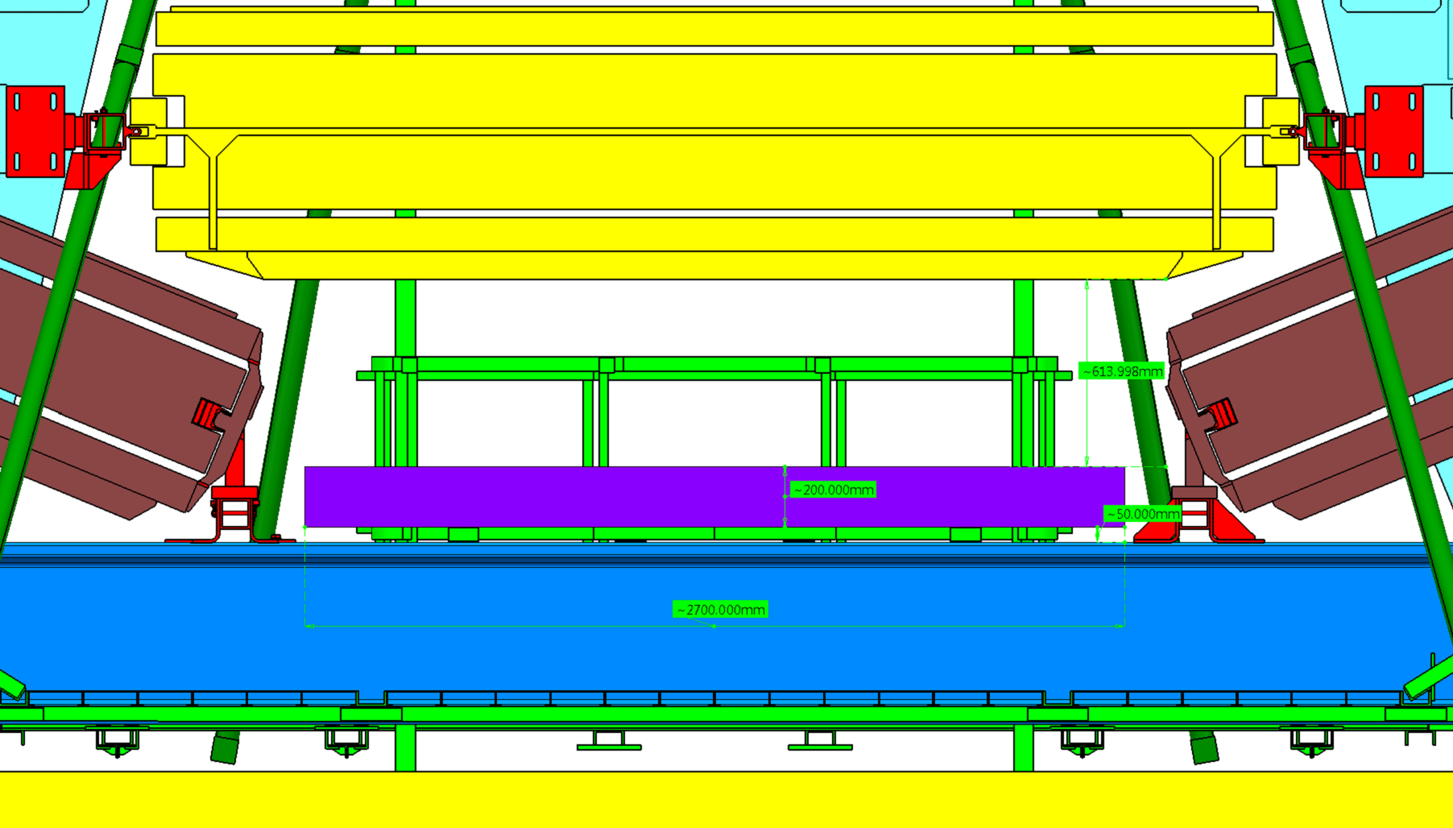
SIDE A,C

Slide 3
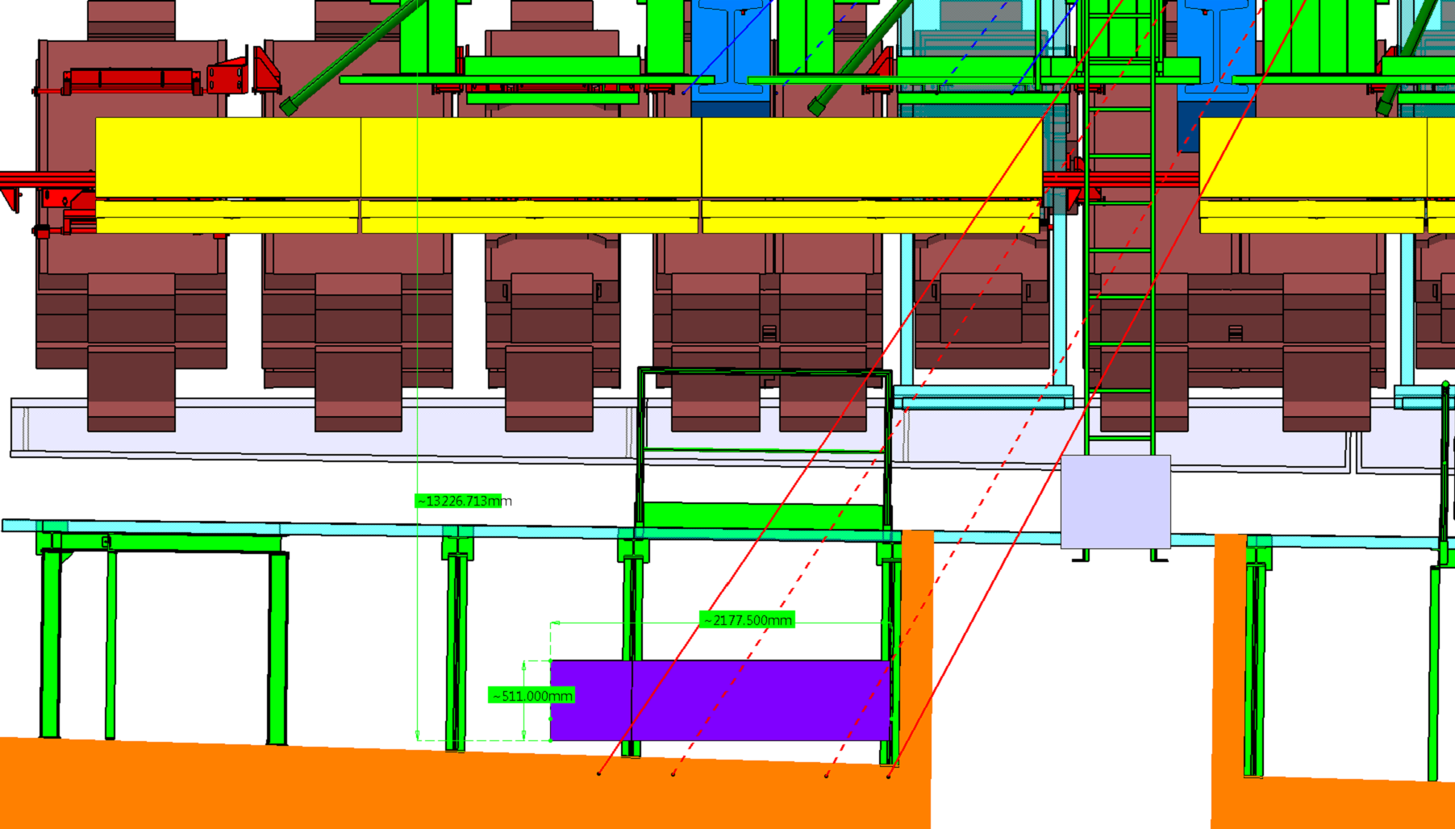
SIDE A
(From IP)
Z 7220

Slide 4
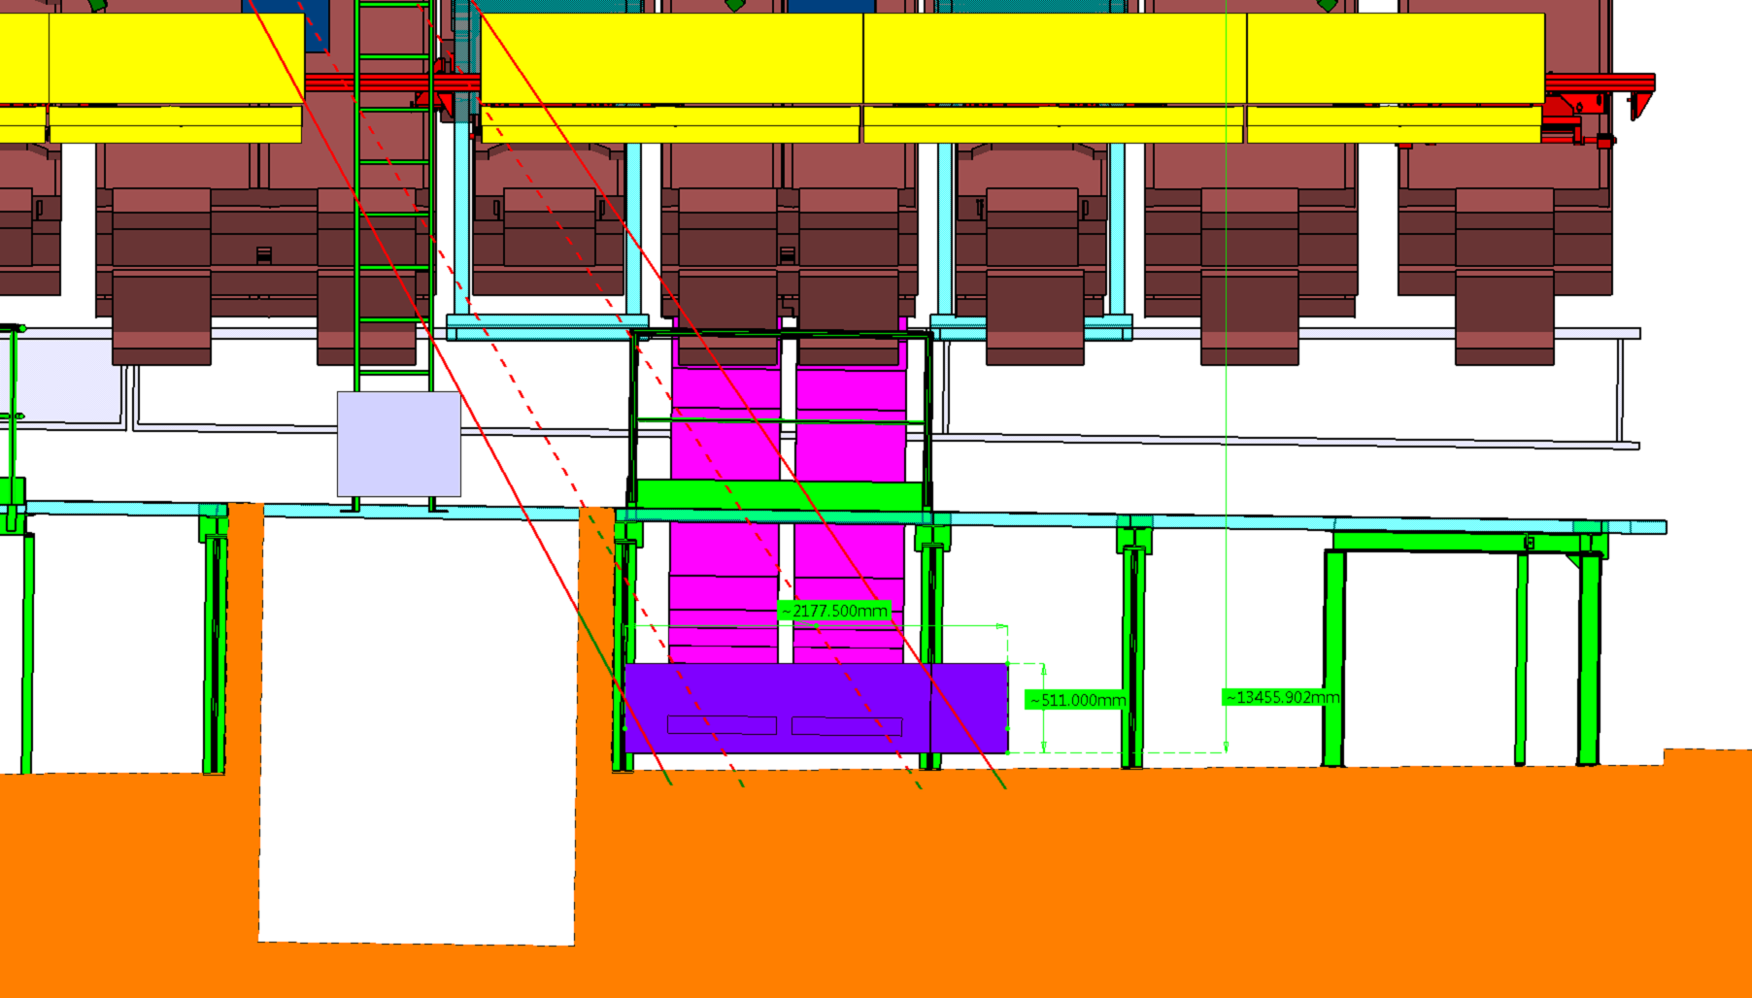
SIDE C
Z 7070
(From IP)

Slide 5
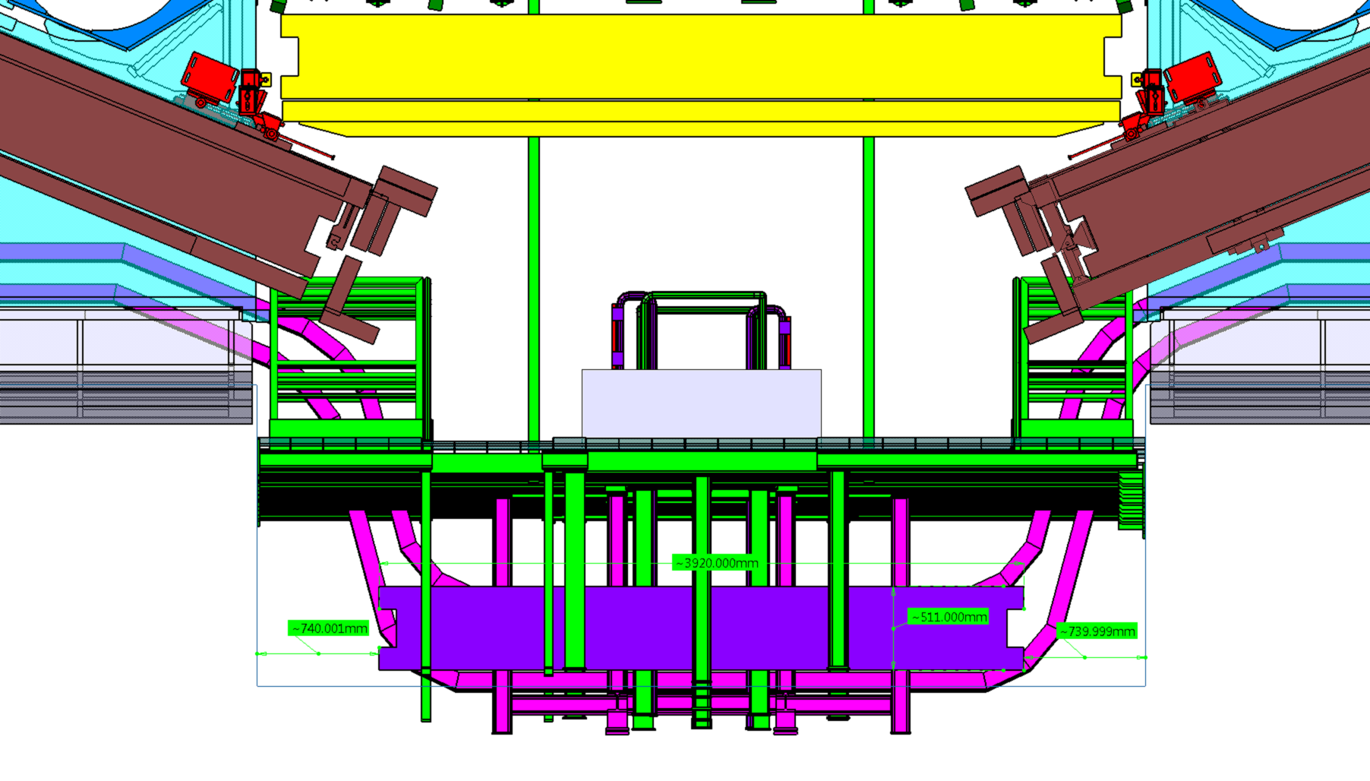
SIDE A,C

