Slide 1
BMG CHAMBER DESIGN

Slide 2
INITIAL CONDITIONS:
Diameter of tube 15 mm;
Pitch 15.1 mm;
Spacer Structure height 170 mm;
Length of assembled tube 1129 mm;
Two multilayers with 4 layers each;
54 tubes in row.

Slide 3
MPI has to design, build and install 12 BMG chambers, placed inside of feet in between existing BMFs (sectors 12 and 14).
Sector 12
side C
side A

Slide 4
BMGs should be placed in BMFs central plane
BML
BMG
BME
BMF

Slide 6
SPECIAL CONDITIONS (for the simplification of the design/assembly):
Only one type of Spacer Structure;
Only one type of Faraday Cage;
Only one type of HV/RO electronic;
Symmetry position of all alignment elements;
All the chambers have the same direction of multilayer in sector (no mirroring of multilayers relatively of central ATLAS cross plane).

Slide 7
However, with all the simplification, MPI has to produce 8 different chambers:
BMG-3A12 (1)
BMG-2A12/2C14 (2)
BMG-1A12/1C14 (2)
BMG-1C12/1A14 (2)
BMG-2A12/2C14 (2)
BMG-3C12 (1)
BMG-3A14 (1)
BMG-3C14 (1)
DIFFERENCE ONLY IN:
placement of cutouts (in fact, in positioning of absent tubes);
placement of holes at the PROTECTIVE COVER.

Slide 8
Simplified view of all the chambers
BMG-3C12
side C
sector 12
BMG-2C12/2A14
BMG-1C12/1A14
BMG-1A12/1C14
BMG-3C14
BMG-2A12/2C14
BMG-3A12
sector 14
side A
BMG-3A14

Slide 9
BMG consists of:
MULTILAYER;
SPACER STRUCTURE;
GAS SYSTEM;
FARADAY CAGE;
HV/RO ELECTRONIC + on-chamber EL-BOXES;
PRAXIAL ALIGNMENT ELEMENTS;
AXIAL ALIGNMENT ELEMENTS;
PROTECTIVE COVER;
SURVEY TARGET SUPPORTS;
KINEMATICAL SUPPORTS;
CHAMBERS HAVN‘T IN-PLANE ALIGNMENT.

Slide 10
One of chambers (BMG-3C12)
Protective Cover with Survey Target Supports
(10mm Al honeycomb by ALUCORE)
Faraday Cage
El-Boxes

Slide 11
HV/RO electronic
Multilayer
GAS system

Slide 12
PRAXIAL alignment elements
Multilayer
Kinematical supports

Slide 13
AXIAL alignment elements
PRAXIAL alignment elements

Slide 14
BMG-3C12 (sample drawing)

Slide 15
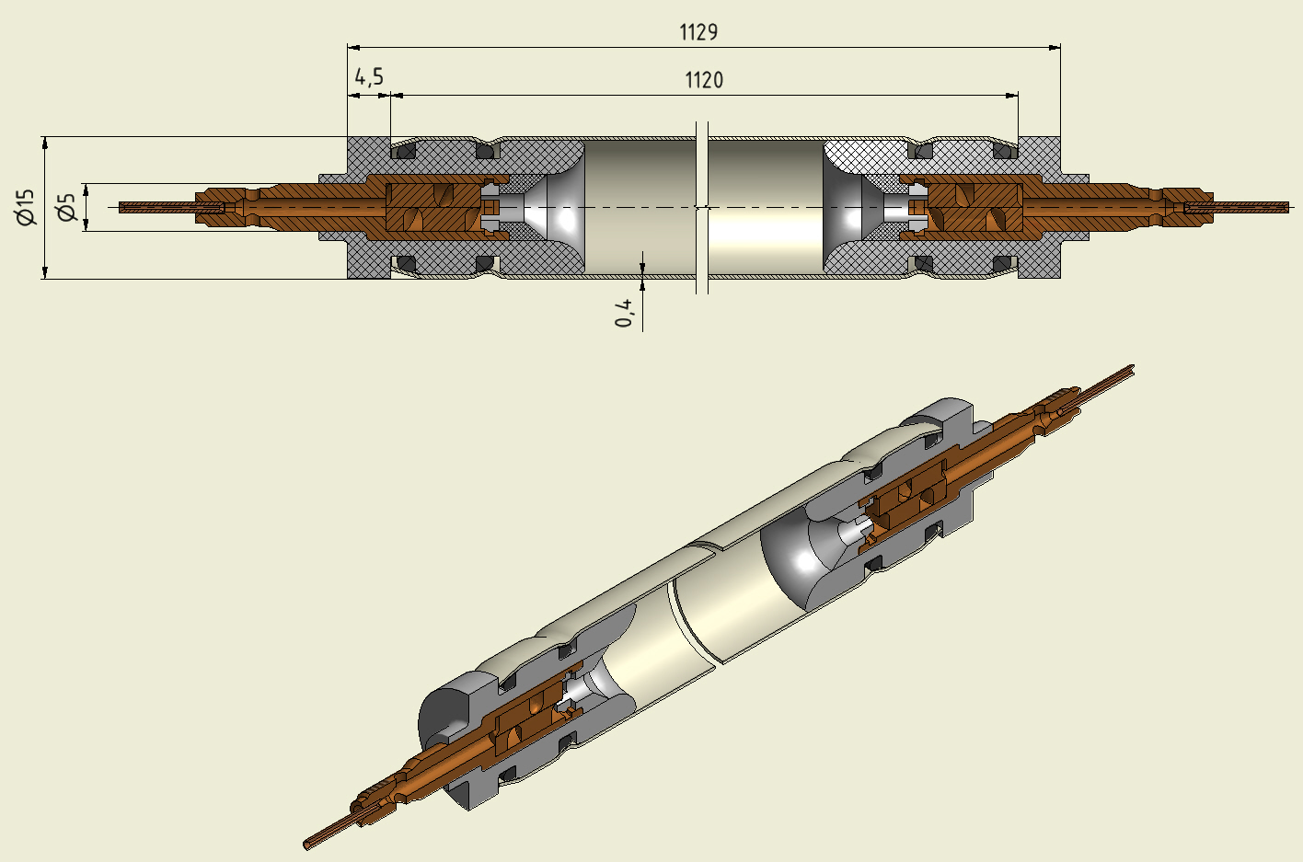
MULTILAYER
Consist of ASSEMBLED TUBES, glued together by
ARALDITE-2011.
CRASTIN LW9330

Slide 16
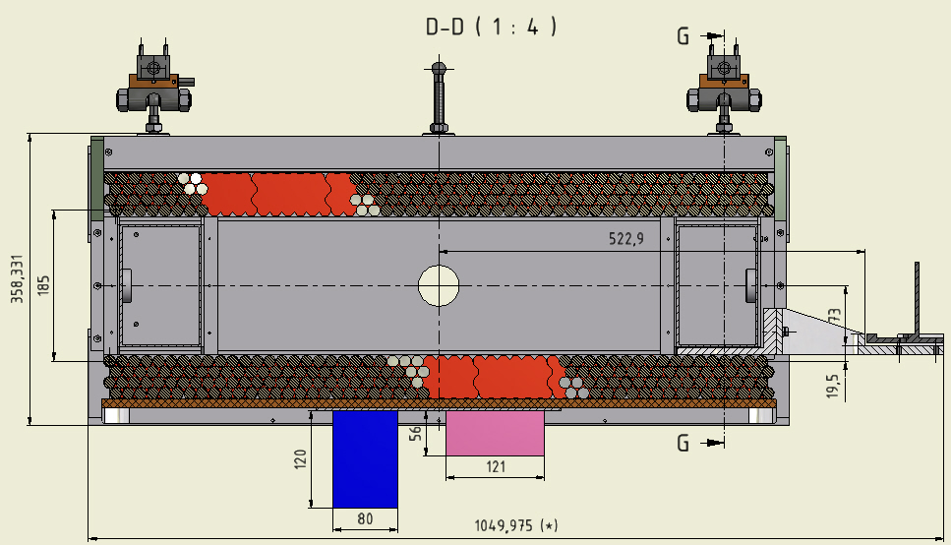
All components glued together by:
ARALDITE-2011

Slide 17
SPACER STRUCTURE
160x60x4
20x20x3
150x100x3
Plastic connector
All components glued together by 3M-490 glue (black)
40x40x4

Slide 18
LOADS for CALCULATIONS

Slide 19
DEFLECTION
0.39864 - 0.36622 = 0.03242 (mm)
2-support side
1-support side

Slide 20
STRESS

Slide 21
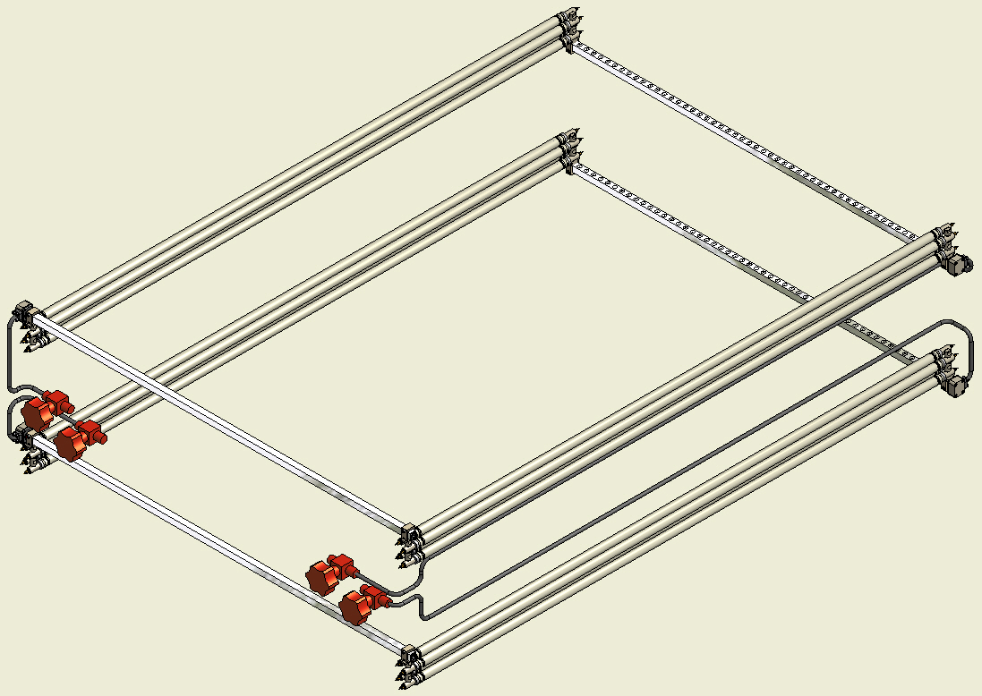
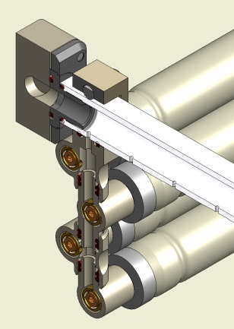
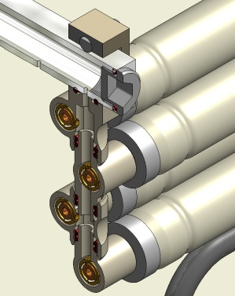
GAS SYSTEM
Gas MANIFOLD

Slide 22
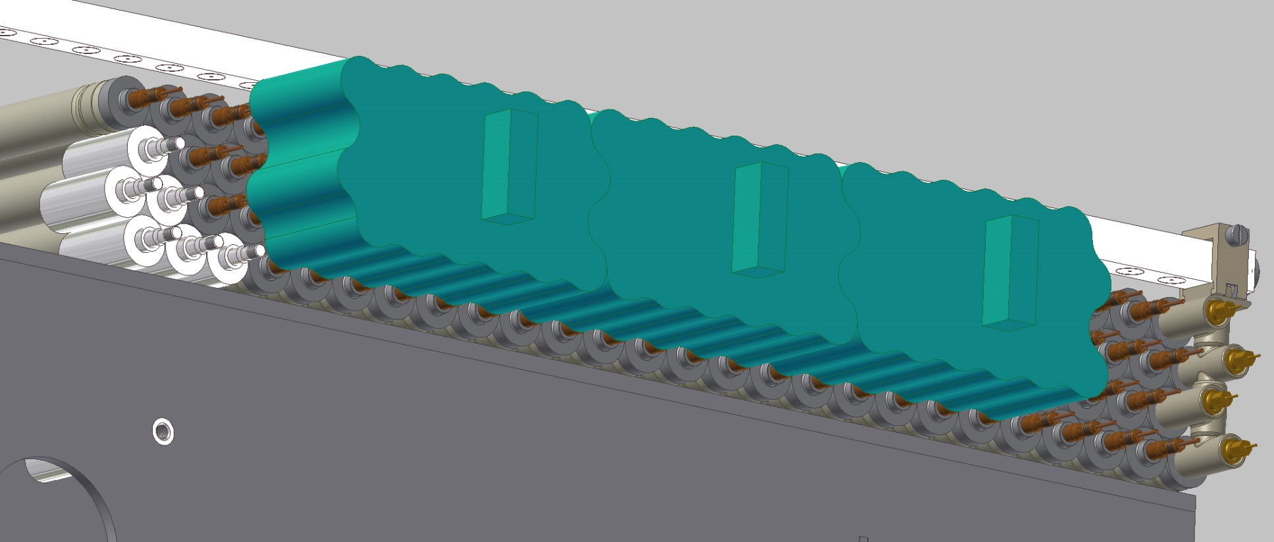
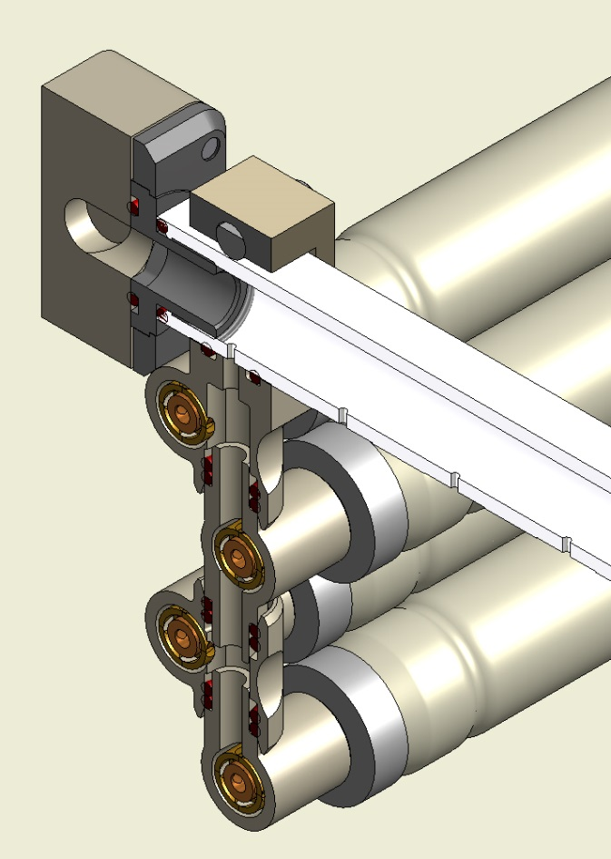
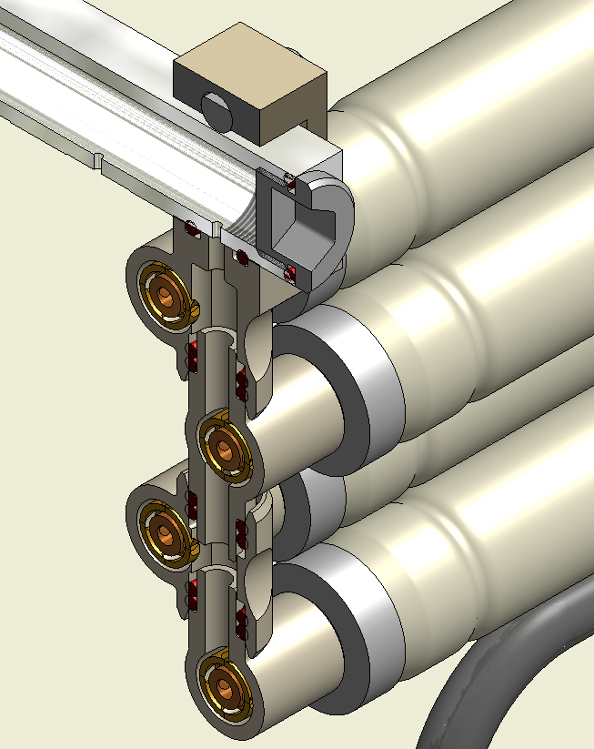
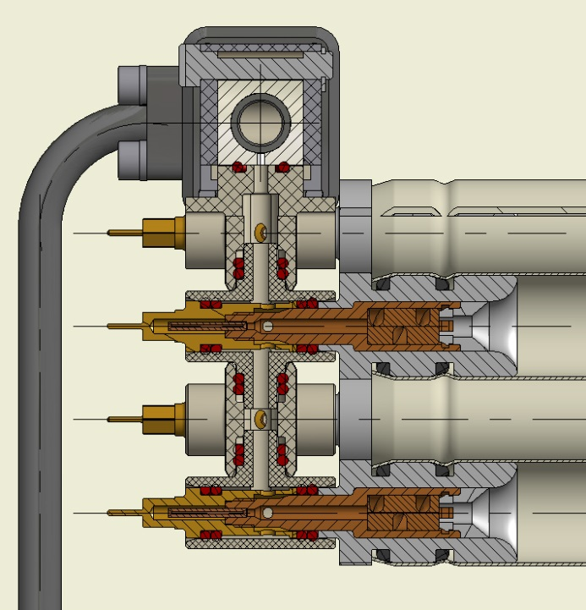

Slide 23
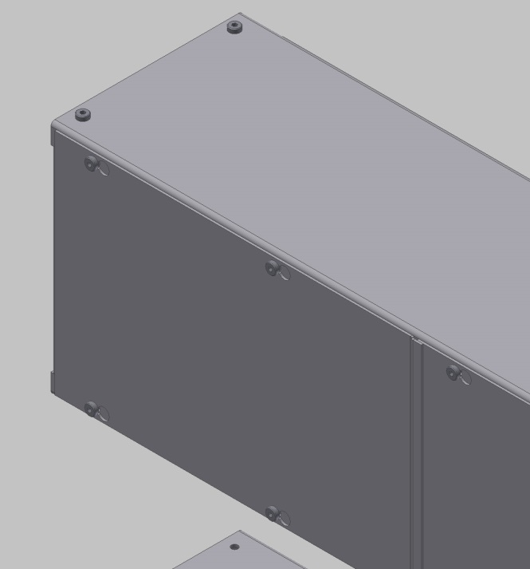
FARADAY CAGE
HV side
RO side

Slide 24
Produced from Al-alloy sheet with 1mm thickness. Anodized.

Slide 25
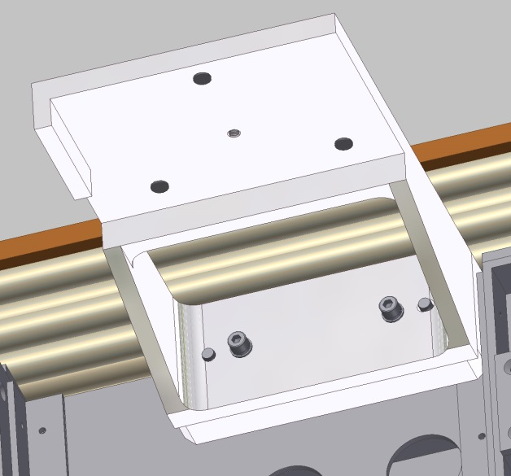
PRAXIAL ALIGNMENT ELEMENTS
(Sample for BMG-1C12/1A14)

Slide 26
PROTECTIVE COVER
- Al-alloy honeycomb 10mm thickness from ALUCORE
- Glued directly to tubes by ARALDITE.
Cover for BMG-3C12
Survey Target supports

Slide 28
KINEMATICAL SUPPORTS
ADJUSTMENT RANGE:
40mm along tubes
30mm along „Z“ (ACS)
30mm along „Y“ (ACS)

