Slide 1
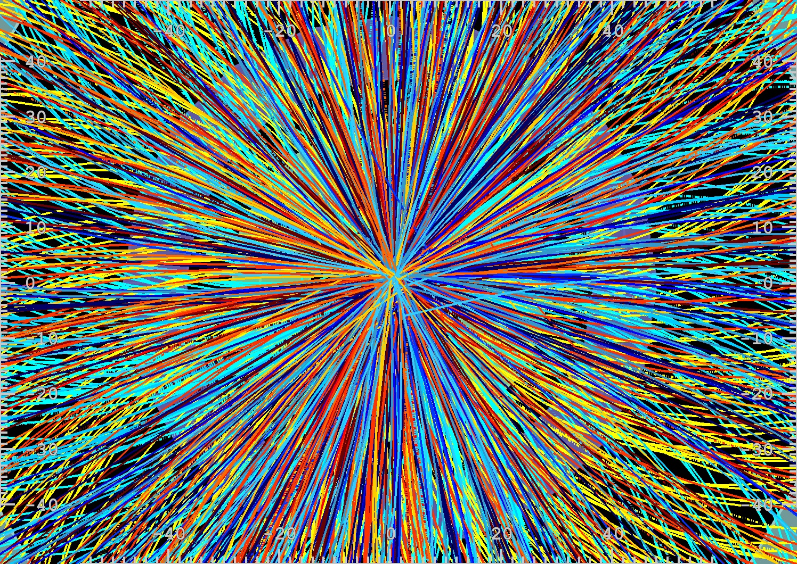
LHC
What has been accomplished?
What lies ahead?
Mike Flowerdew, MPP Munich
Science week, 04/12/13

Slide 2
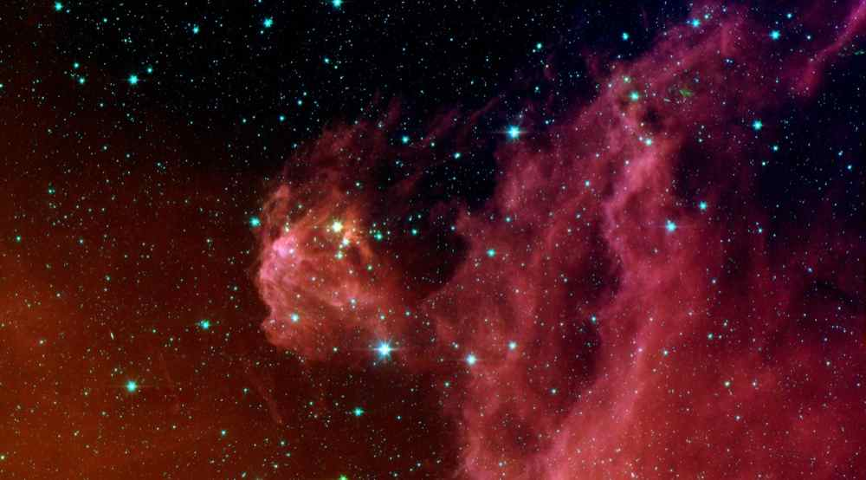
Extra dimensions?
Origin of mass?
Weakness of gravity?
Neutrino mass?
Some big questions
Are there new symmetries/interactions?
Where is the antimatter?
Dark matter?
3 generations?

Slide 3
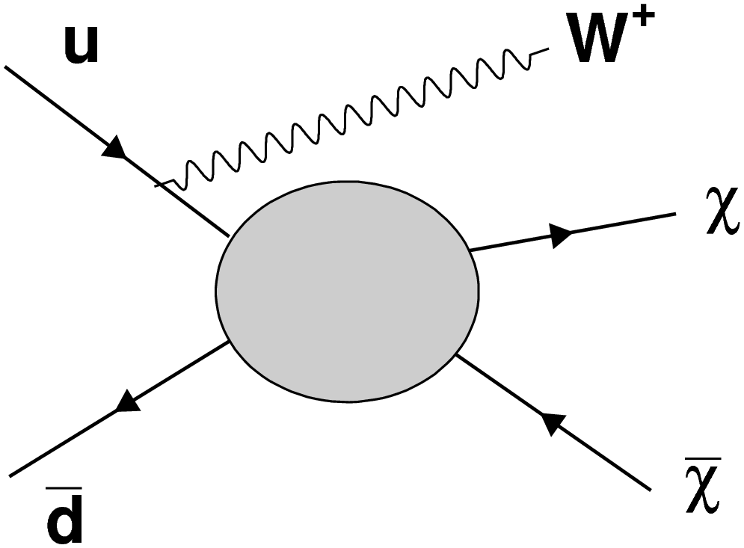
BEH mechanism & Higgs boson
Extra dimensions?
SUSY, quantum black holes
Origin of mass?
KK towers, graviton production
Right-handed neutrinos?
Weakness of gravity?
Neutrino mass?
Flavour physics & new interactions
SU(2)_{R}, Z‘/W‘, leptoquarks
Are there new symmetries/interactions?
Where is the antimatter?
+ many more
Dark matter?
Higgs coupling, searches
3 generations?
arXiv:1309.4017 [hep-ph]

Slide 4
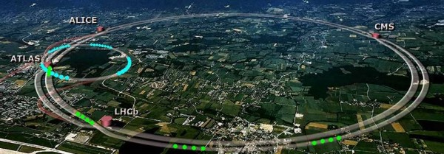
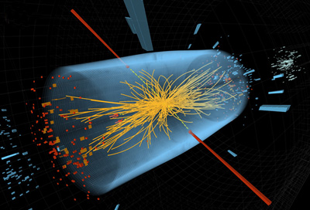
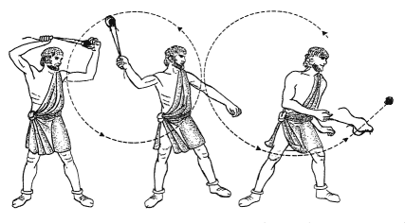
The Large Hadron Collider

Slide 5
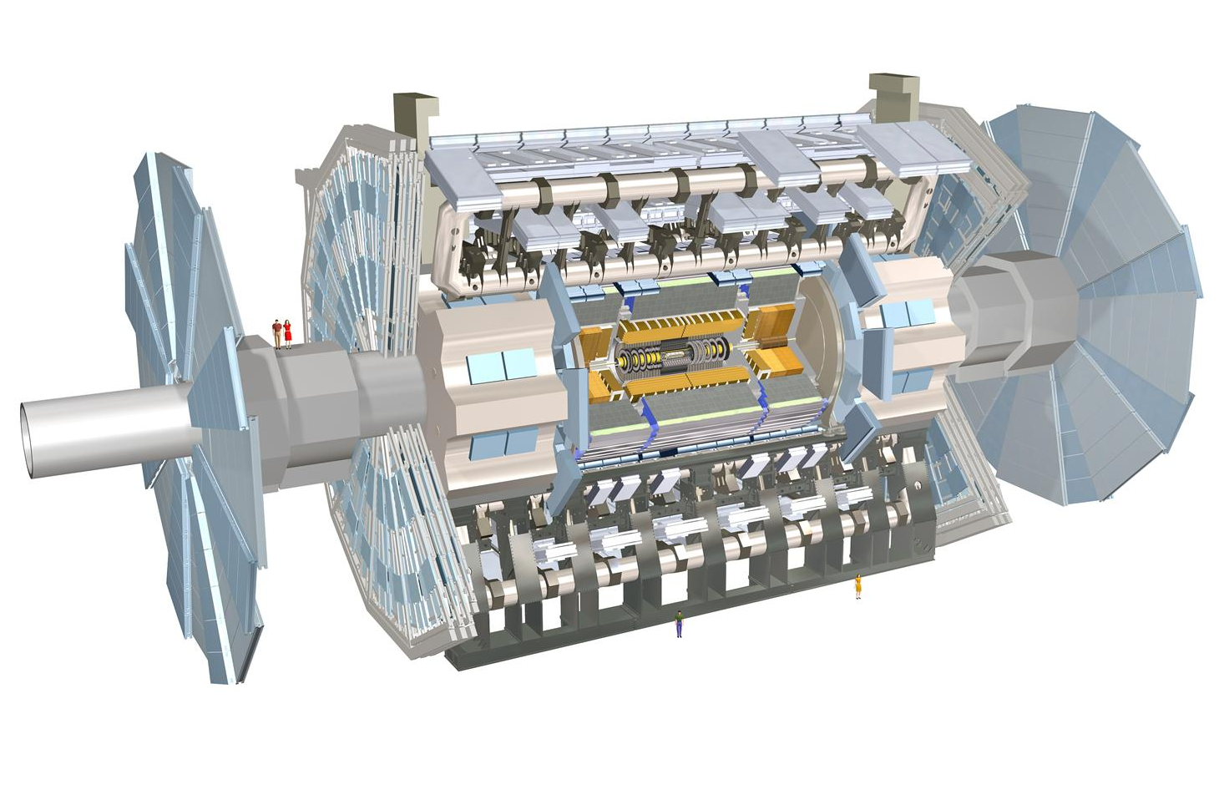





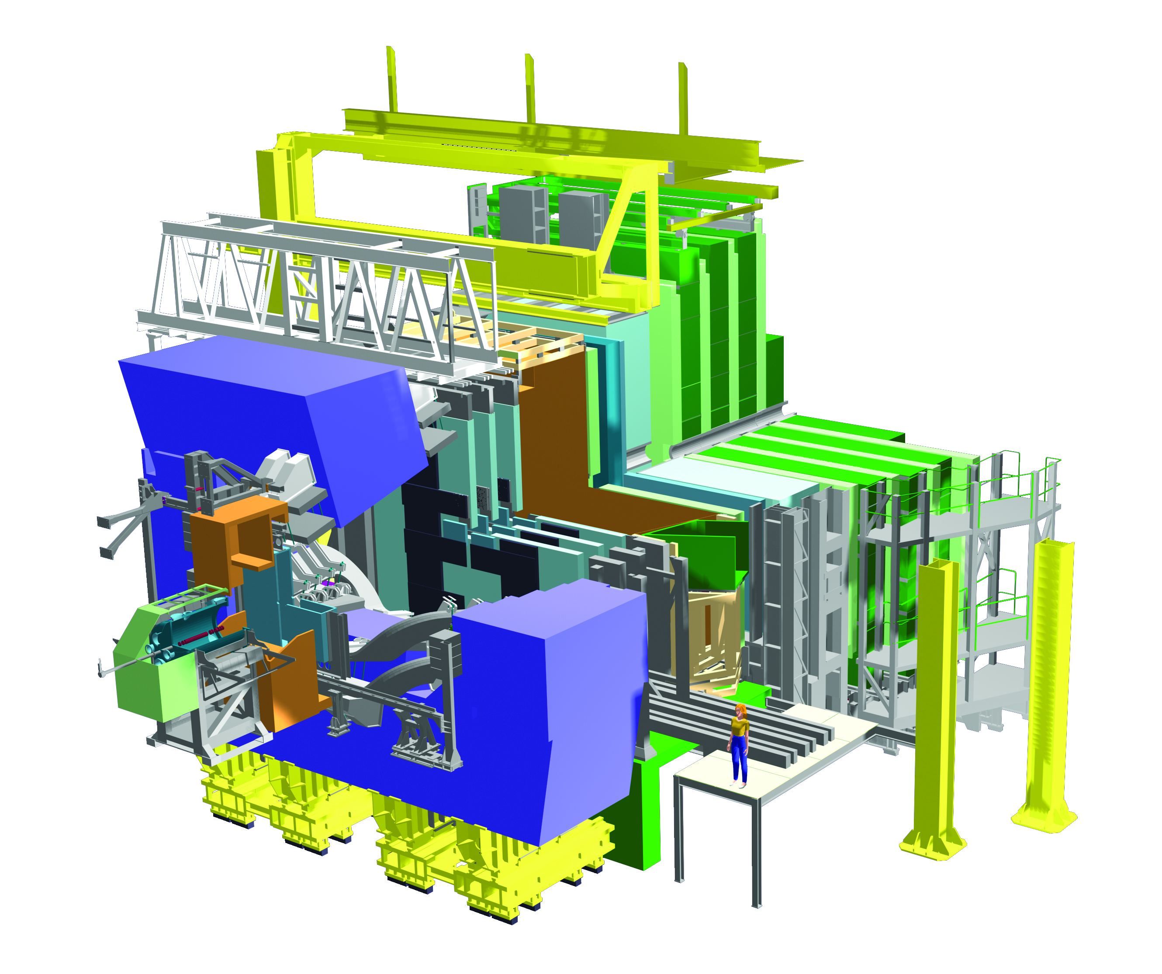


Slide 6
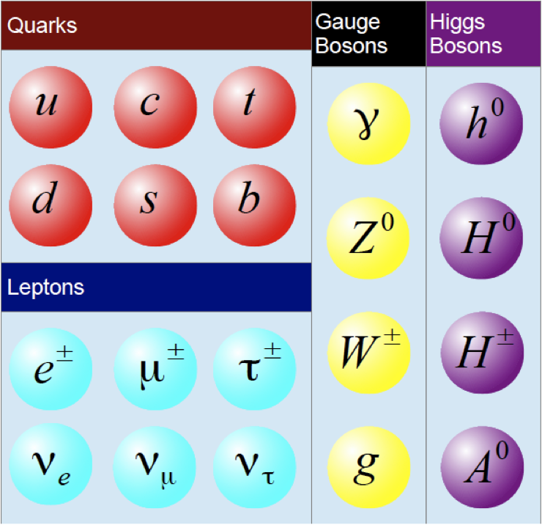
THE STANDARD MODEL℠
Force carriers
Matter particles
or should be
All are
produced at the LHC
More matter particles

Slide 7
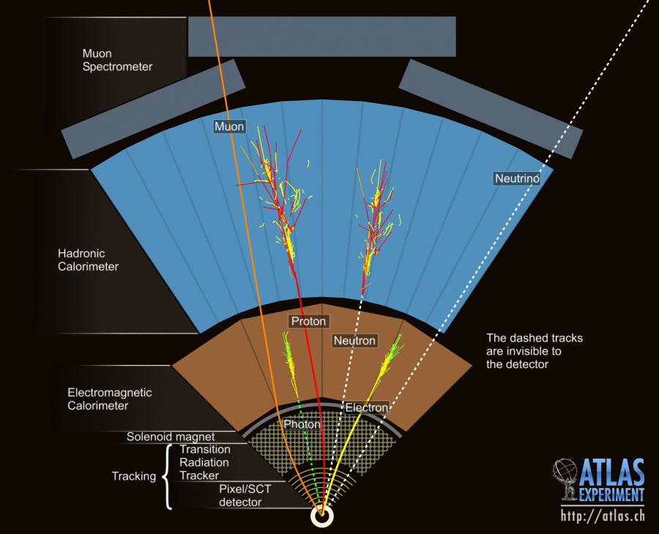

Slide 8
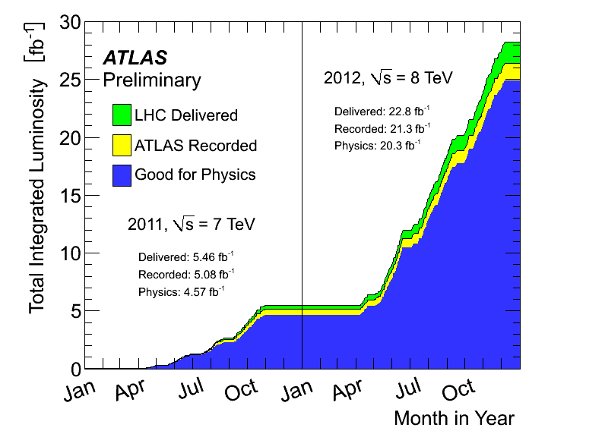
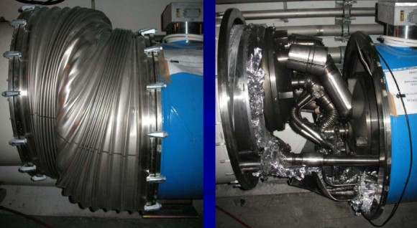
Run I summary
Luminosity
We need data, and lots of it!
2,000,000,000,000,000 p-p collisions per experiment in 2 years
Lots of chances to produce exceptionally rare processes
Only about one in a million events recorded
All achieved at reduced collision energy following 2008 incident
- Full repairs now underway for Run II
Energy
Year | Energy [TeV]
2009 | 0.9-2.36
2010-2011 | 7
2012 | 8
2015-? | 13

Slide 9
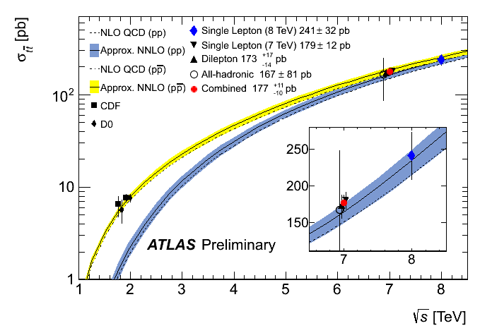
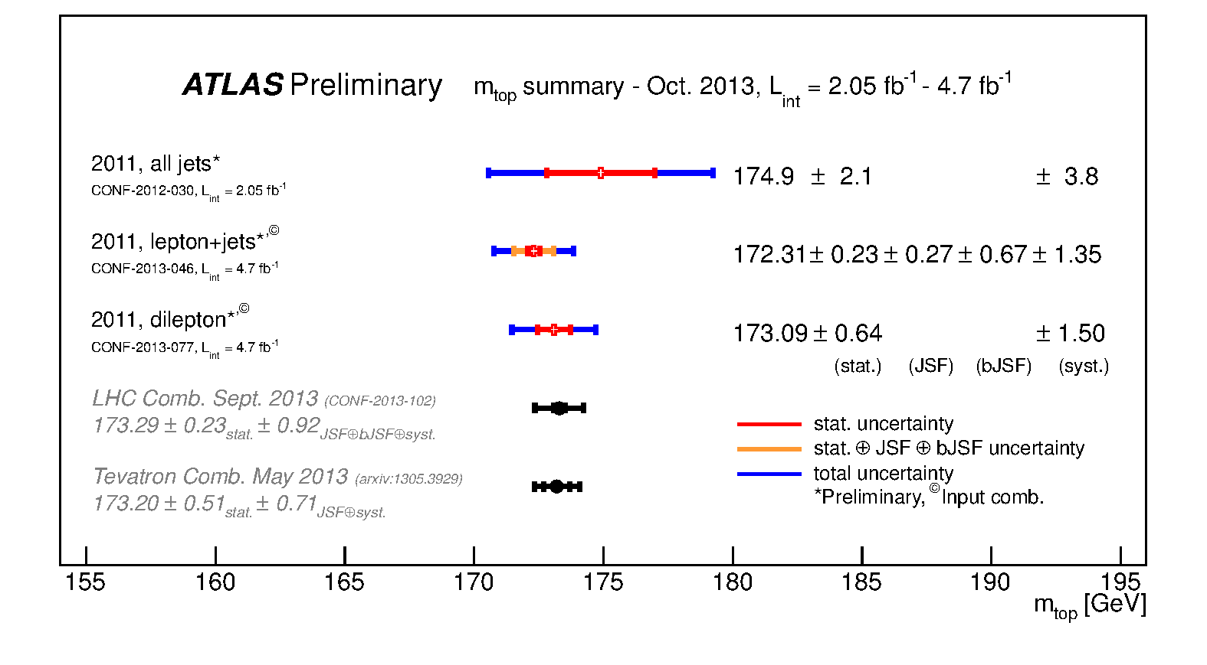
Precision measurements
The top quark is the most
massive (known) elementary particle
LHC production rate over 10 times greater
than in previous experiments
Large sample to study production and decay
Example: measuring the top mass
LHC
Tevatron
Top production rate
Collision energy
Top mass
173 GeV

Slide 10

Observed particles (pre-LHC)
Particles with mass
Forbidden by gauge symmetry
Another story

Slide 11
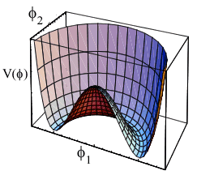
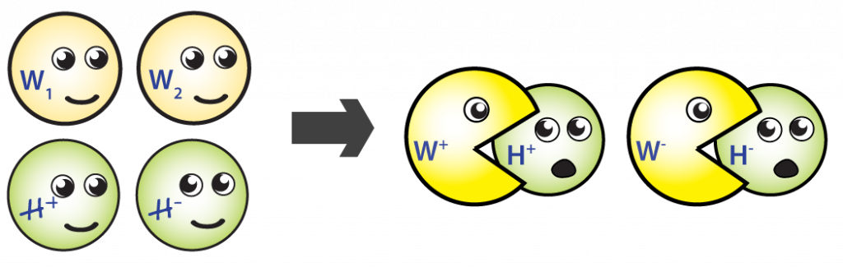

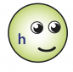
The BEH mechanism
(Brout-Englert-Higgs)
BEH field: φ₁, φ₂
4 components overall
Vacuum state breaks
gauge symmetry
Massless bosons from SM symmetries
Physically observable bosons: W±, Z, γ
One field left over:
The Higgs Boson

Slide 12

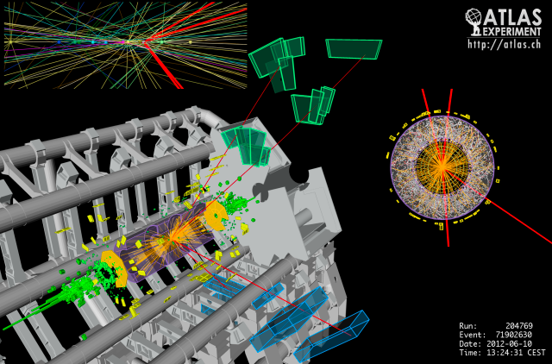
Higgs detection at the LHC
Precision channels
(good mass resolution)
High rate, substantial background
Low rate, but very pure
Other channels
(poor mass resolution)
and many more

Slide 13


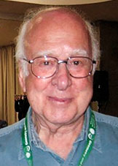

How discoveries are made
Ongoing measurements:
Mass
Couplings
Spin/parity
So far consistent with expectations
The 2013 Nobel prize honoured this successful prediction

Slide 14
Revenge of the SM
✔
✔
✔
✔
✔
✔
✔
✔
✔
THE STANDARD MODEL WINS!
✔
✔
✔
✔
✔
✔
✔
✔

Slide 15

But is that it?
If SM parameters are random, how lucky are we?
Good example: Higgs boson mass should be much, much bigger
It‘s like winning with odds of 1/100,000,000,000,000
What is more believable: that this just happened or that the game is rigged?

Slide 16
Three solutions
Non-fundamental Higgs
GUT scale lowered
Composite Higgs:
difficult for a number of reasons
Eg extra dimensions
0
New particles/interactions
Eg supersymmetry (SUSY)
All rely on observations of new phenomena with mass near m_{h}
ie at most ~1000 GeV = 1 TeV

Slide 17
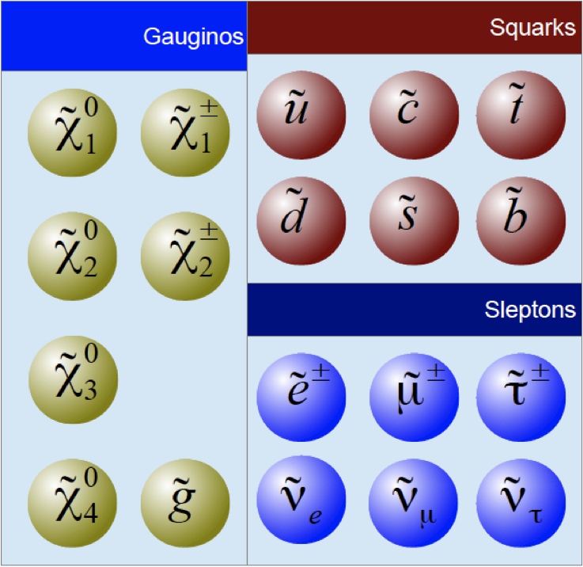
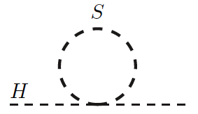
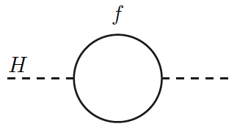
Supersymmetry @ the LHC
Hypothesis: every SM particle gains a partner, different only by ½ a unit of spin
Solves hierarchy problem via (nearly) exact cancellation of Higgs mass loops
Bonus: potential dark matter candidate
(or neutrino masses)

Slide 18
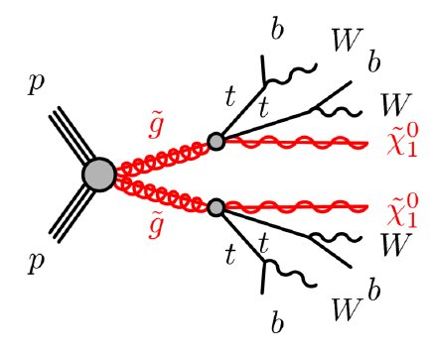
Supersymmetry @ the LHC
Hypothesis: every SM particle gains a partner, different only by ½ a unit of spin
Solves hierarchy problem via (nearly) exact cancellation of Higgs mass loops
What does it look like? There are many possibilities
Squark/gluino production: high rate, any SM particles possible in decays

Slide 19
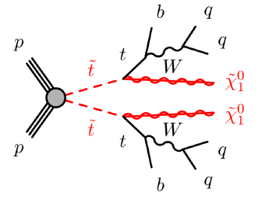
Supersymmetry @ the LHC
Hypothesis: every SM particle gains a partner, different only by ½ a unit of spin
Solves hierarchy problem via (nearly) exact cancellation of Higgs mass loops
What does it look like? There are many possibilities
Squark/gluino production: high rate, any SM particles possible in decays
Stop/sbottom production: lower rate, must be light for naturalness

Slide 20
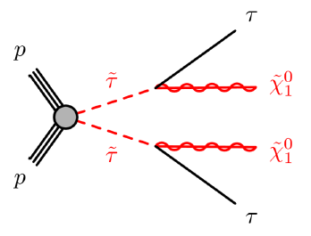
Supersymmetry @ the LHC
Hypothesis: every SM particle gains a partner, different only by ½ a unit of spin
Solves hierarchy problem via (nearly) exact cancellation of Higgs mass loops
What does it look like? There are many possibilities
Squark/gluino production: high rate, any SM particles possible in decays
Stop/sbottom production: lower rate, must be light for naturalness
Slepton/gaugino production: could still be seen if squarks are very massive

Slide 21
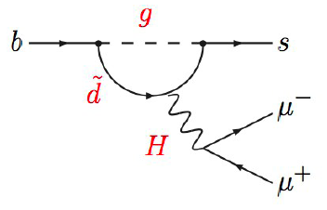
Supersymmetry @ the LHC
Hypothesis: every SM particle gains a partner, different only by ½ a unit of spin
Solves hierarchy problem via (nearly) exact cancellation of Higgs mass loops
What does it look like? There are many possibilities
Squark/gluino production: high rate, any SM particles possible in decays
Stop/sbottom production: lower rate, must be light for naturalness
Slepton/gaugino production: could still be seen if squarks are very massive
Indirect effects: usually in flavour physics
See Alexander Mann‘s talk yesterday for more
B_{s}→μ⁺μ⁻ now observed!
No enhancement over SM
LHCb-CONF-2013-012

Slide 22
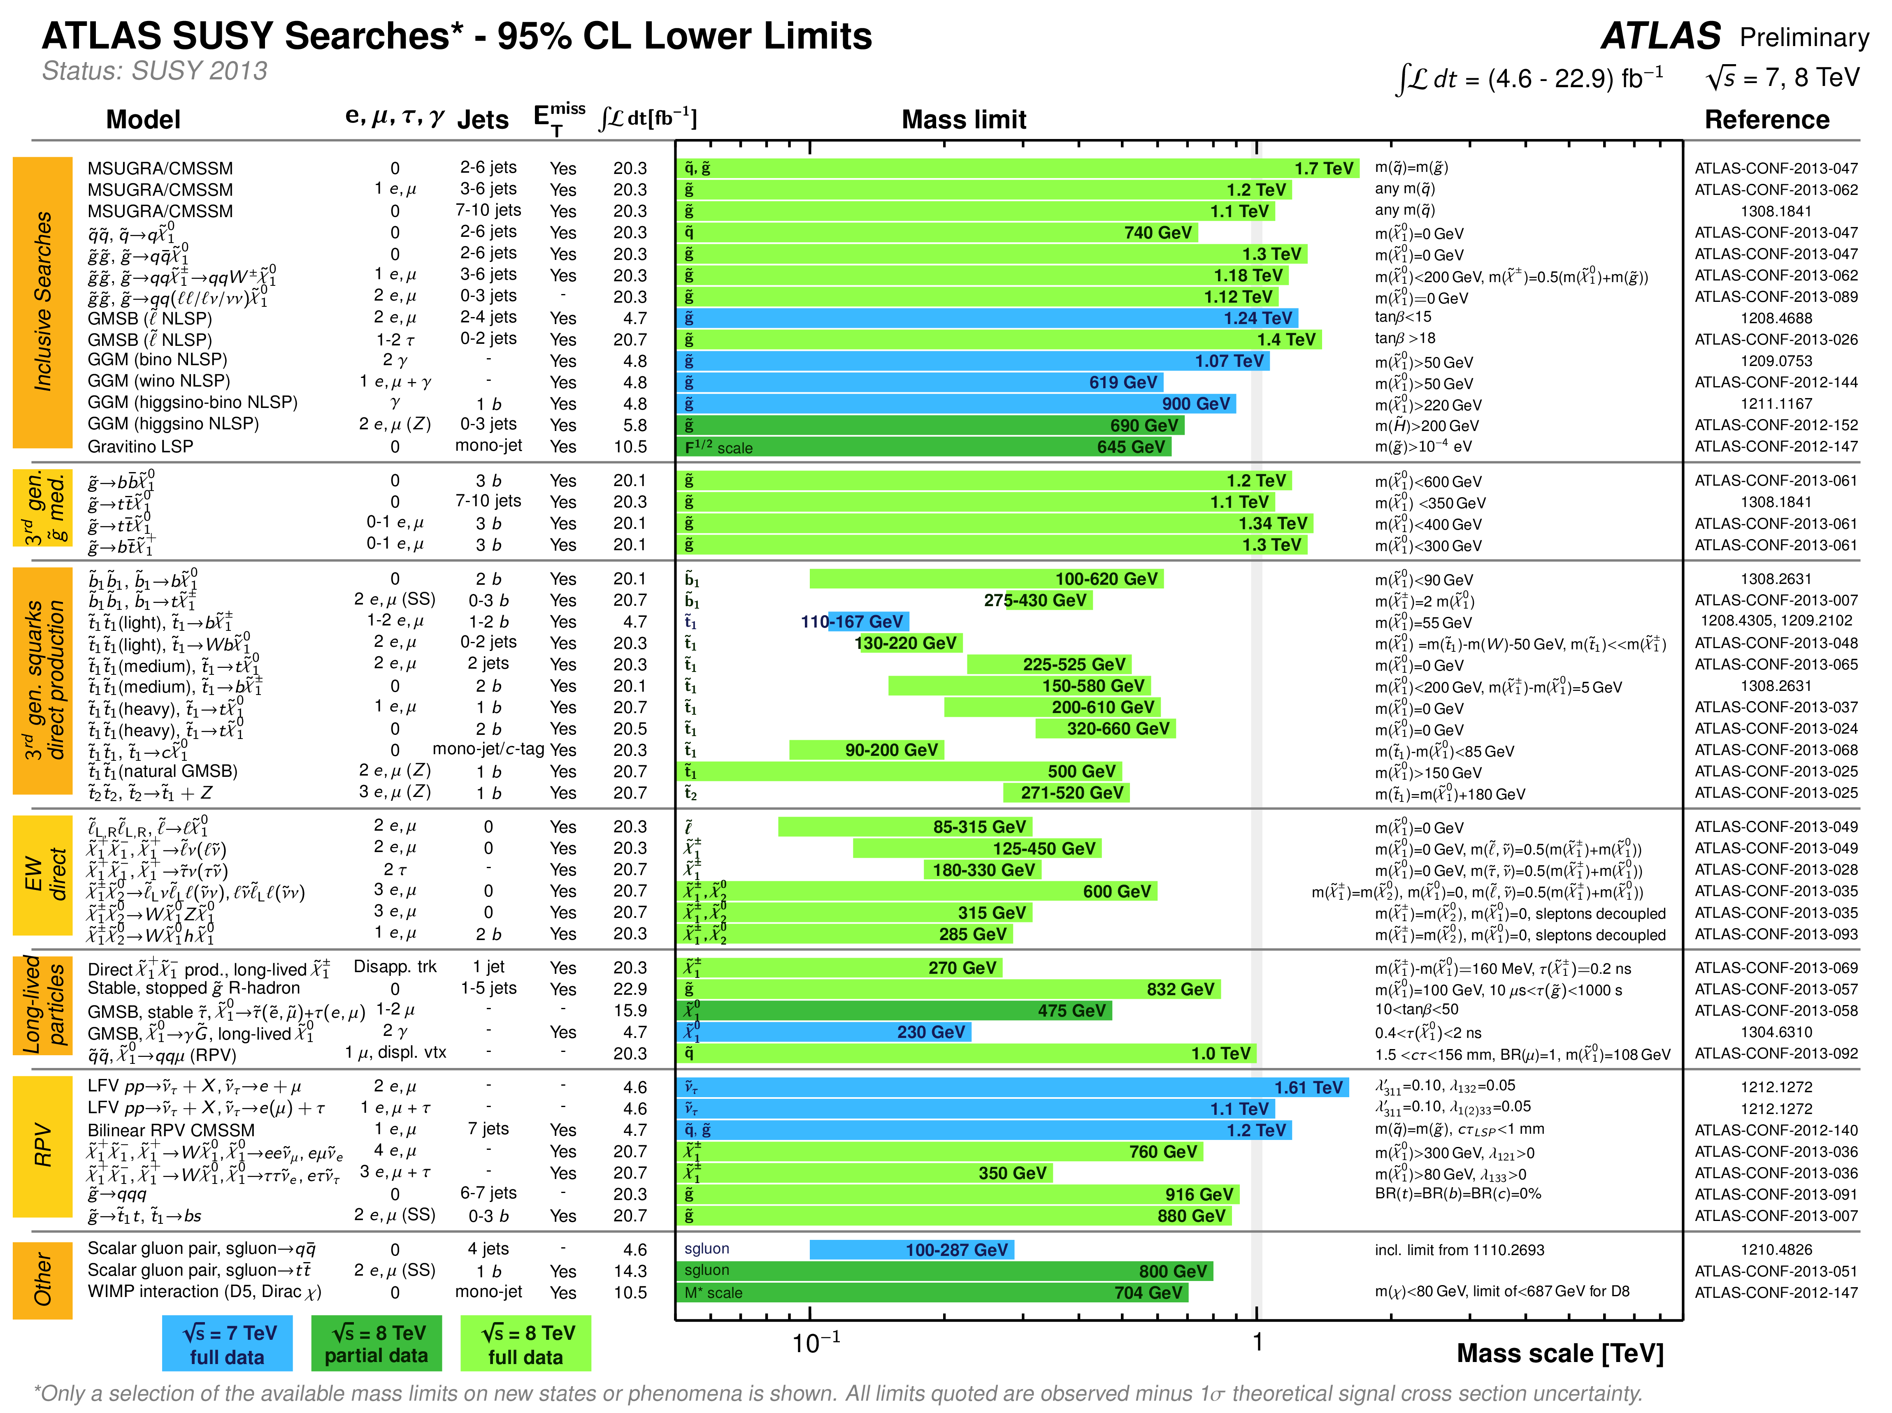
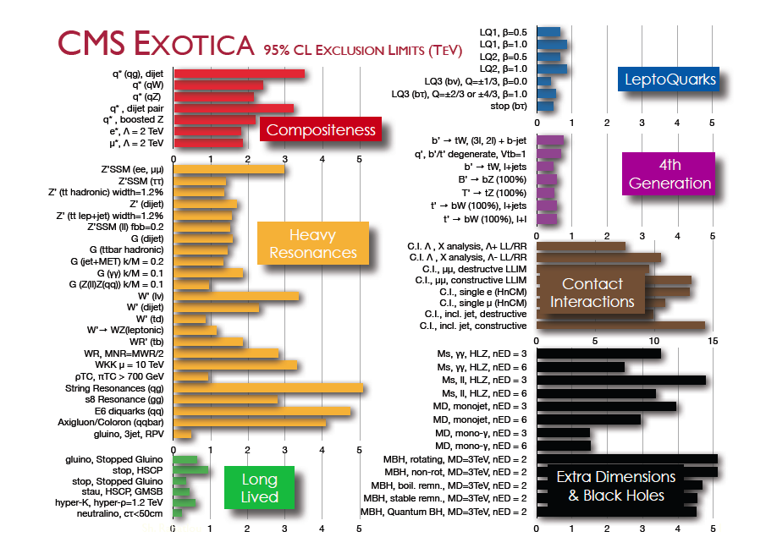
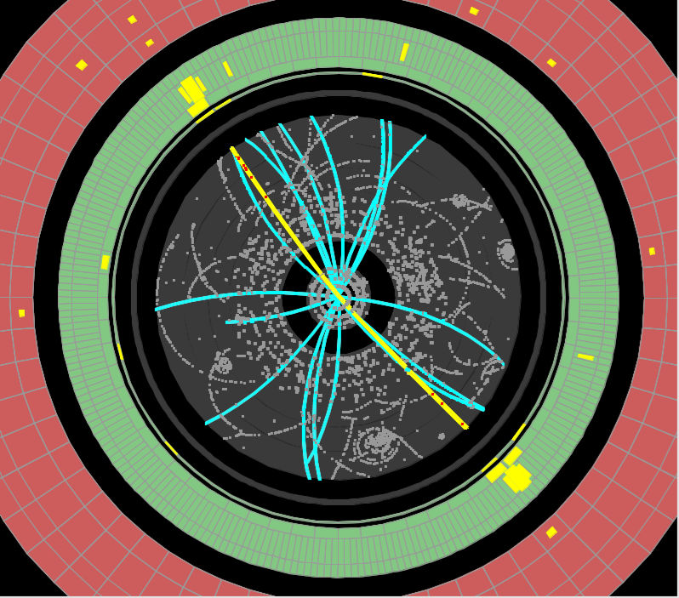
1 TeV
1 TeV
1 TeV
So far, no significant deviation from the Standard Model
No evidence for SUSY or other non-SM physics
Precision measurements in agreement with expectation
Caution: Many caveats and loopholes
Example: Limited sensitivity to late-decaying particles, surprises could still be lurking in the Run I data!
Late decay
Prompt decay

Slide 23
Extra dimensions?
Origin of mass?
Weakness of gravity?
Neutrino mass?
Some big answers?
Are there new symmetries/interactions?
Where is the antimatter?
Dark matter?
3 generations?

Slide 24
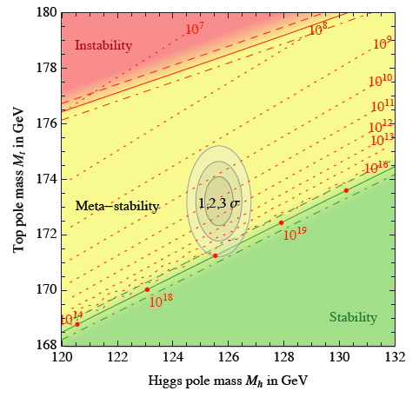

Is that it?
Buttazzo et al, arXiv:1307.3536v2 [hep-ph]
If the SM is all that is,
the universe appears to be
finely tuned and metastable
Finely-tuned: Apparently unlikely selection of fundamental constants
Metastable: Our universe not the „best“ vacuum, but stable for current life of universe
arXiv:1307.3536
How can this be?
Are we in a multiverse?
Do balancing pressures place us near the critical point?
Maybe

Slide 25
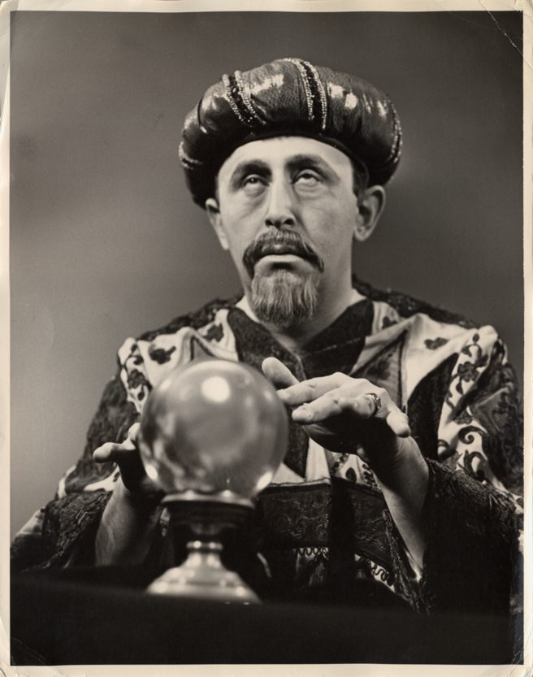
The future
Warning: all simulation past this point!

Slide 26
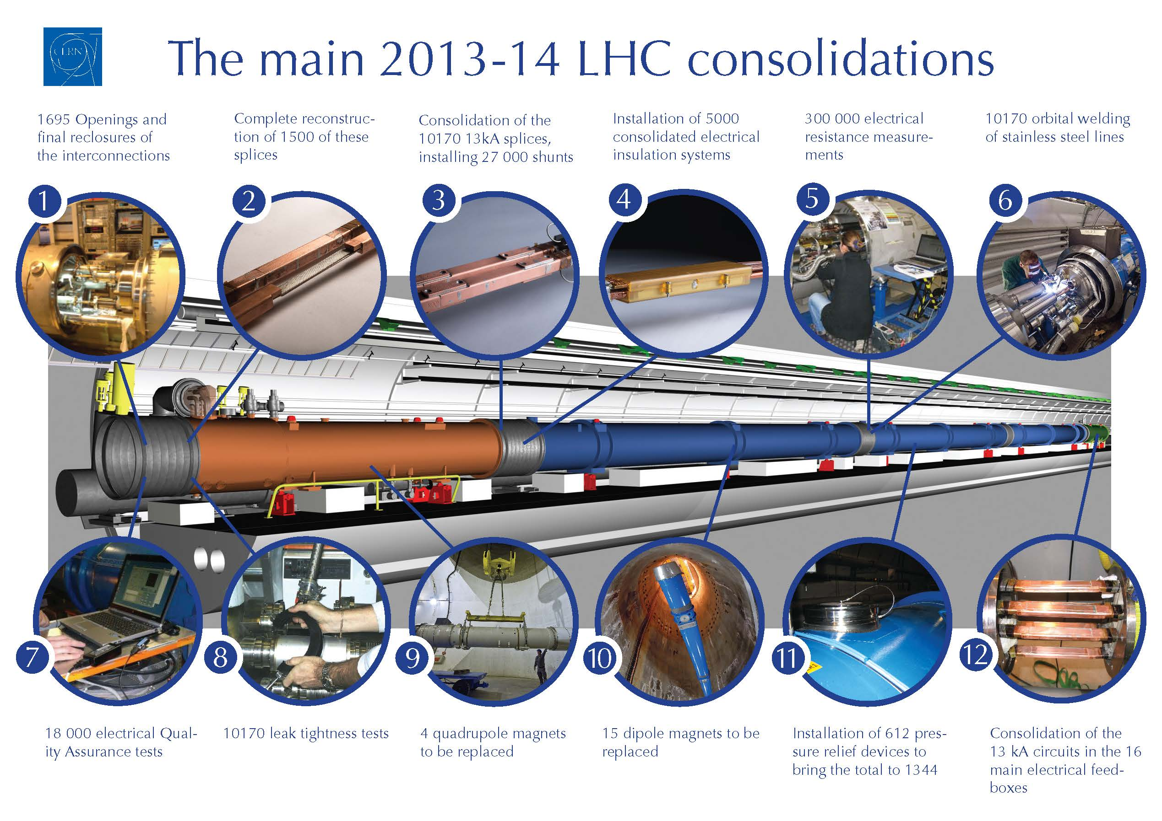

Slide 27
The LHC upgrade plan
→ 5 x 10³⁴ cm⁻²s⁻¹
with luminosity leveling
3 Long Shutdowns (LS)
~ 3000 fb⁻¹
Collected luminosity
NOW
→ ~ 2 x 10³⁴ cm⁻²s⁻¹
LS3
→ 1x10³⁴ cm⁻²s⁻¹
design luminosity
~300 fb⁻¹
LS2
High Luminosity (HL)-LHC
→ 7 x 10³³cm⁻²s⁻¹
~50 fb⁻¹
√s=13 TeV
LS1
25 fb⁻¹
√s=7/8 TeV
2013-14
2018-19
2023-5
Year
Phase 0 upgrade
Phase 1 upgrade
Phase 2 upgrade
At each stage: beam improvements and detector repairs, upgrades
Eventual target: >100 times today‘s dataset

Slide 28
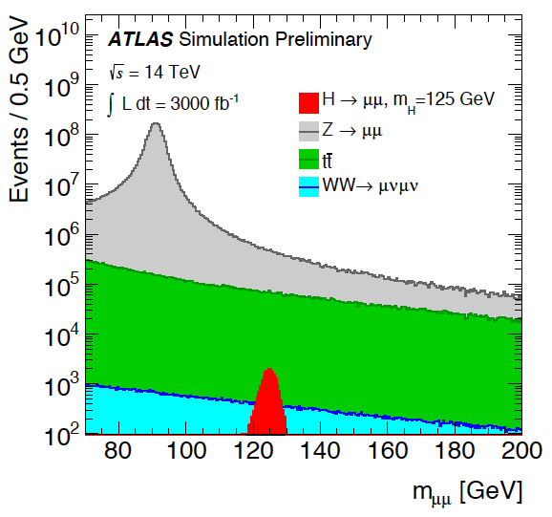
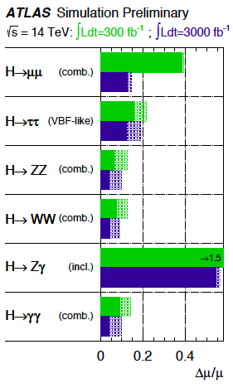
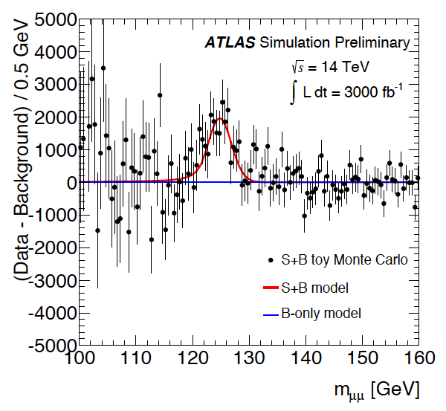
Future prospects: Higgs
10-100x current dataset will allow rare events to be observed
Eg h→μμ: ~1 in 5000 decays
Probe interaction strengths to O(5%)

Slide 29
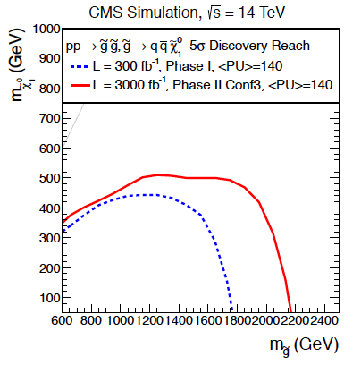
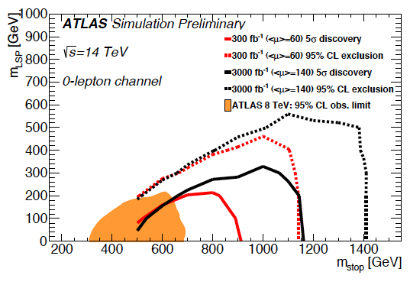
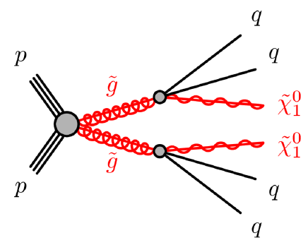
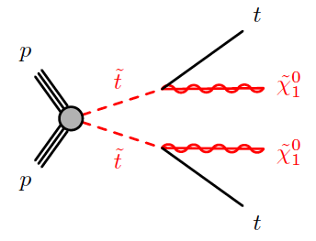
Future prospects: SUSY
Many searches statistically limited
  More luminosity improves sensitivity to rarely produced particles
  Higher energy increases production rate of massive particles
Maintaining sensitivity to all scenarios challenging
HL-LHC discovery reach
HL-LHC discovery reach
Current limit

Slide 30
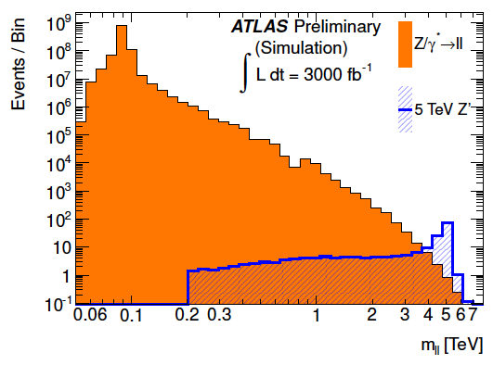
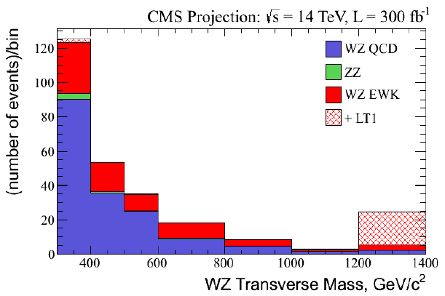
Future prospects: some other examples
q‘
q
HL-LHC exclusion reach
W
W
Z/γ*
Z
q
q
Non-SM interactions?
Current limit
New forces would emerge at the LHC through the production of new gauge bosons (Z‘)
Exceptionally clean dilepton signatures are possible
Exclusion sensitivity could reach nearly 8 TeV
The LHC can collide gauge bosons too!
Rare, needs large luminosity to observe
Deviations in diboson kinematic distributions could hint at unexpected processes

Slide 31
Conclusions
Beams back
3.5 TeV beams
In the first three years of high energy collisions, the LHC and its experiments have really delivered
Brout-Englert-Higgs mechanism confirmed as the origin of mass
No sign of anything else, so far, but questions about the Standard Model remain
Higher energy LHC will help probe even higher mass scales to attempt answer these questions
2010
First HI collisions
2011
Max # bunches (1380)
Peak lumi reached
2012
Higgs boson announced
p+Pb running
2013
2014
Collisions restart
2015

